Slide 1
1
2 3
Learn how content architecture fits into content strategy
Discuss the impact of content architecture in the digital ecosystem
Explore how to start influencing content in your organization

Slide 2

Common Problems Experienced by Clients
Stale or noncompliant content is on live sites
Reuse strategies are not in place
Teams are constantly doing the same work over… and over.. and over
Maintenance and governance is a disaster
Issues with a “lift and shift” not readjusting for AEM requirements

Slide 3

Content Strategy is getting the right content
to the right user, at the right time, for the right reasons with the right call to action, within the right budget
on the right channel, through the right device and medium to attract and retain a clearly-defined audience,
with the resources allocated, using the systems currently available,
to drive profitable customer interaction
by using the right data – in real time

Slide 4
Content Strategy: The Core Practices
User Experience
Content Architecture
Content Marketing
Editorial & Brand Strategy

Slide 5
Content Strategy: The Core Practices
User Experience
Content Architecture
Content Marketing
Editorial & Brand Strategy
General emphasis & association with
content strategy

Slide 6
Content Strategy: The Core Practices
User Experience
Content Architecture
Content Marketing
Editorial & Brand Strategy
Delighting the Customer

Slide 7


User Experience
(the presentation)
Structure
Content Architecture
(the infrastructure)
Content
Consume Systems
Strategy
Editorial Strategy
(the conversation)
Content Marketing
(the connection)
Message

Slide 8
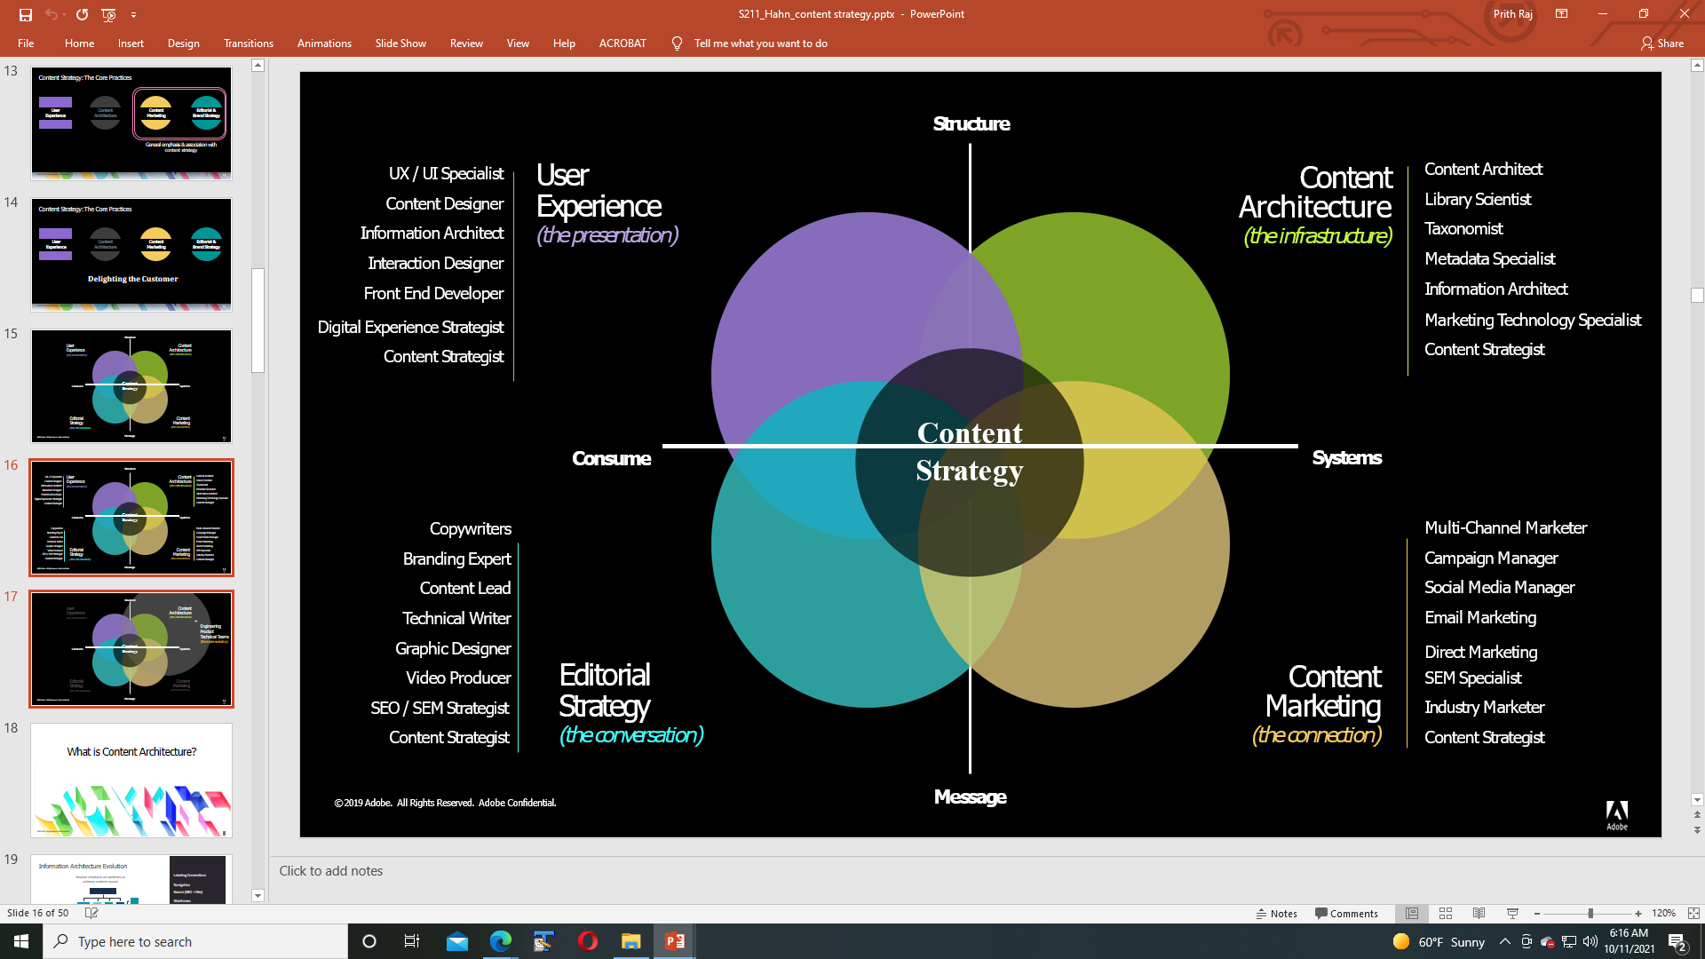

Slide 9

User Experience
(the presentation)
Structure
Content Architecture
(the infrastructure)
+
Engineering
Product
Technical Teams
(the implementation)
Content
Consume Systems
Strategy
Editorial Strategy
(the conversation)
Content Marketing
(the connection)
Message

Slide 10
Information Architecture Evolution
Heavier emphasis on websites as primary content source
Labeling Conventions
Navigation
Search (SEO + Site) Wireframes
Metadata Management Taxonomies
User Behaviors Usability
10

Slide 11

Content Architecture Focus
Labeling Conventions Inheritance Navigation
Search (Publish, Author & SEO Properties)
Metadata Management Taxonomies
Internal User Behaviors Usability
Heavier emphasis on overarching system and user alignment across the marketing and technology stack
Structured, Adaptable Content Authoring Model
Workflow Processes
Localization / Global Requirements System Interoperability
Content Reuse
Dynamic / Personalized Content
Permissions and Access Levels Ongoing Governance Integration Requirements Dynamically Populated Content Platform Alignment
11

Slide 12
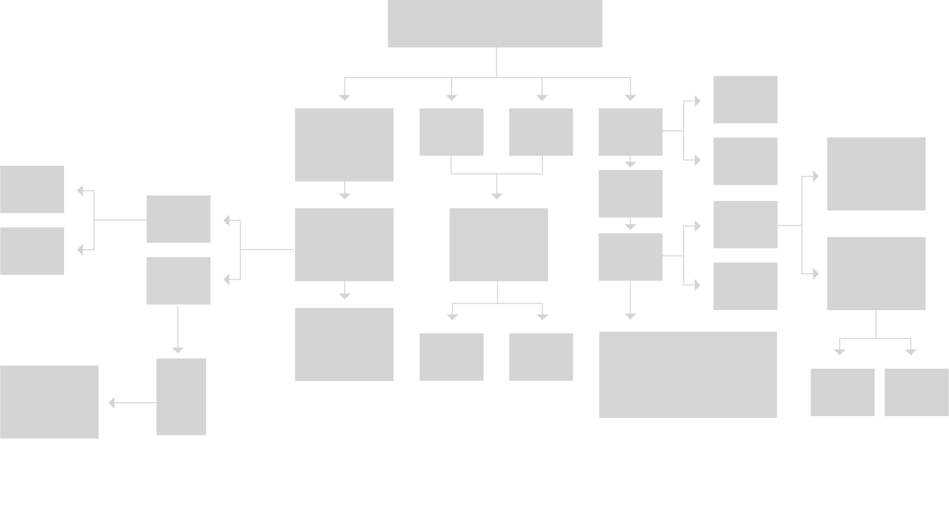
One Page - Many Structures
The JCR Content Tree
Information Architecture v. Content Architecture
12

Slide 13


Content Architecture = *ability
Findability Usability
Reusability Scalability
Manageability Evolvability
Customizability
Flexibility*
23

Slide 14
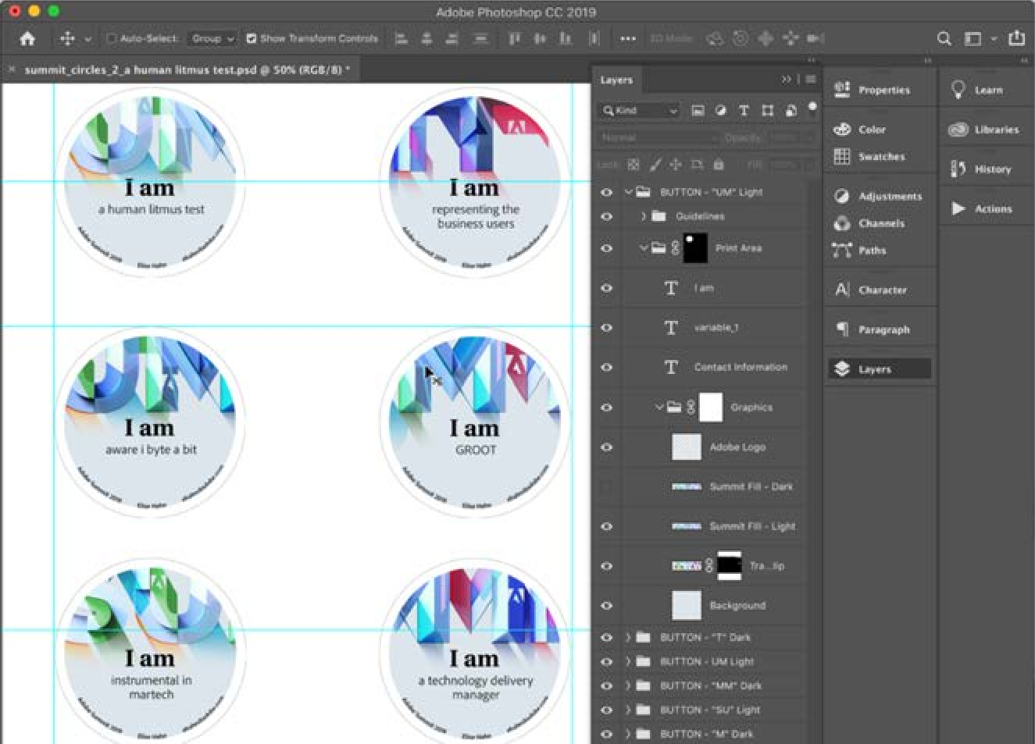

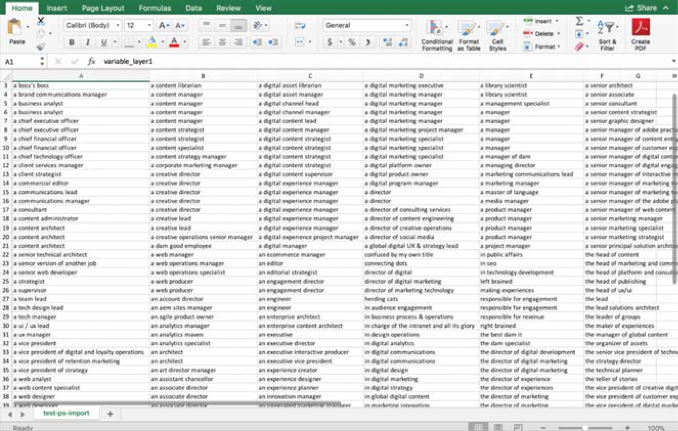
Over 650 objects with 300+ unique classifications Wasted effort without actionable information
14

Slide 15



































A System Without Content Architecture
Lack of metadata for findability and discoverability
Inability to target the personalized content to the known audiences
Inability to track efficacy of messaging
No data to contribute to audience profiles – including role identification, personality traits, communication preferences for humor or directness
Inefficiencies for content reuse – Attendees unable to request reproduction of existing buttons
And More
© 2019 Adobe. All Rights Reserved. Adobe Confidential. ₂₇

Slide 16
Activities for Content Architecture
Define what your goals are within AEM and the Adobe ecosystem
Establish a core group and distributed core group if next steps are eminent
Audit your content
Identify all the systems using content and the corresponding metadata
Opportunities to identify controlled vocabularies
Opportunities to eliminate redundancy and create cross functional working teams
16

Slide 17
Activities for Content Architecture
ZEROTH LAW
Use cross-functional groups to do information sessions
Establish a governance
Test hierarchies in AEM Assets & Sites
Permissions
Authoring Groups
Content Types
Localization Strategy
Inheritance Rules
Metadata Application
Define Ownership
17

Slide 18





Traffic Size
Symantec.com
3.3 billion requests/month
150 million Page Views/month
By The Numbers
40k No of Pages
150G:Size of Repository
Velocity
200/30: No of Authors (total/concurrent)
Global
20 Countries
12 Languages

Slide 19








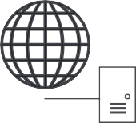
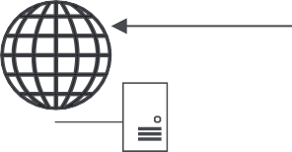


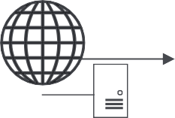




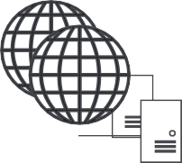



Logical (Decisions Framework) Architecture
AEM Licenses Base Decisions
Data Center 1
Physical/Virtual/Cloud
OS(Linux/Windows) Storage (SAN/NAS)
Architecture Questions Dispatcher @ Author
AEM Publish
Dispatcher
CDN (Akamai)
Cluster
Web Server Cluster
Internal Zone
LB @ publish
Dispatcher Web Server
AEM Author Pair
Data Center 2
HA: DR, Multi-DC
Caching Logical
Preview Lifecycle TarMK, MongoMK
AEM Publish Cluster
Dispatcher Web Server Cluster

Slide 20



Decision Table Deep dive
Decision Point Options
Virtual/Physical All Virtuals | All Physicals | Hybrid |Cloud OS Linux| Windows
Storage Attached | SAN | NAS Dispatcher@Author Yes | No
LB @ Publish Yes (n:n) | No (1:1)
HA: DR, Multi-DC Single DC/Multi DC, DR:Yes| No,
CDN : Yes |No
Caching CDN, Custom Dispatcher Cache, Custom App cache Preview Lifecycle Yes | No
Author Scalability TarMK| MongoMK | Customized Solution
Base
Architectural
Logical
20

Slide 21




























Multi Tenancy current State
Web Property
Atln
SDL
Web
intrnt
W^{UW} eb P^{V}r^{Y}oGRperti^{N}e^{DC}s/Appl^{N}i⁻c^{P} ation^{W}s^{S}
Dev
WS-1
WS-2
WS-3
_{Insta}N-_{n}Pub_{ces} WSP-Pub
AEM Instance
Pub
Pub1
Pub2
A^{Pu}E^{b} M Publ^{N}i⁻s^{Pu}h^{b}
Dev-Pub
WS-Pub3
WS-Pub2
WS-Pub-3
NS-
DAM-Instance
Sym-Instance
Cust-Instance
AEM Instance
P-Instance
WS-Instance
Instance
21

Slide 22






Multi Tenancy current State
Web Property
Atln
SDL
Web
intrnt
UW
VYGR
NDC
N-P
WS
Dev
WS-1
WS-2
WS-3
Instance
Instance
Instance
Instance
Instance
Instance
AEM Instance
Pub
Pub1
Pub2
Pub
N-Pub
N-Pub
WSP-Pub
Dev-Pub
WS-Pub3
WS-Pub2
WS-Pub-3
DAM-Instance
Sym-Instance
Cust-Instance
NS-
Instance
P-Instance
WS-Instance
22

Slide 23























TARGET STATE : INSTANCE GOVERNANCE
Finite number of Instances – with Governance
New instance should be created only when:
Independent branding and experience
Independent Dev teams and stakeholders – with totally different integrations
Totally different operational SLAs required
Example Symantec/Norton
Request Flow
Authors
Akamai – Caching/Acceleration
AEM Publish Farm – Data center 1
Visitors
AEM Author Pair
AEM Publish Farm – Data center 2
Request Flow
Authors
Akamai – Caching/Acceleration
AEM Publish Farm – Data center 1
Visitors
AEM Author Pair
AEM Publish Farm – Data center 2
Request Flow
Authors
Akamai – Caching/Acceleration
AEM Publish Farm – Data center 1
Visitors
AEM Author Pair
AEM Publish Farm – Data center 2
23

Slide 24

Migration Strategy
Technologies before AEM: Teamsite, Drupal
AEM adopted three years ago
Major web presence on AEM
Long tail of migrations continue to this day
Two options for migrations
Assisted Migrations (scripted, automated)
User driven (new platform for new content + retire older content)
24

Slide 25


Globalization
2 Level Structure
EN is master
Language (eg French) – followed by Locale
Content Translation with SDL World Server
Custom Integration
Custom
Impl
1
English Master
Portugese Master
Spanish Master
French Master
Chinese Master
Live Copy
2
3
en-au
en-us
en-ca
pt-pt
es-es
fr-fr
ch-cn
en-sg
en-uk
en-in
pt-br
es-br
fr-ca
ch-tw
ch-hk
25

Slide 26
Globalization Decisions Deep Dive
Decision | Options
Country Site Content | All pages | Selective Pages
Domain | Single Domain | Country Specific Domains
Content Structure | English→language→locale) | English→Locale) |Custom
Propagation Mechanism | Multi Site Manager |Language Copy | other
Integration Mechanism | 3rd Party (ClayTablet)| Connector | Custom
Translation | Manual| Automated | Hybrid(MTPE)
Source | Blueprint | Existing branch or Page
Rollout Configuration | Manual | Auto
26

Slide 27





Cisco.com –
Front Door to Cisco’s Business
375 Million
MONTHLY PAGE VIEWS
17M
ANNUAL SEARCHES
1+ Million
DIGITAL ASSETS
15 Million
MONTHLY VISITORS
99.99% UPTIME | 70 LOCALES | 650K+ PAGES
Every visit is an opportunity to market, sell, and support our customers and engage employees.
Marketing
Sales
Support
Employees

Slide 28
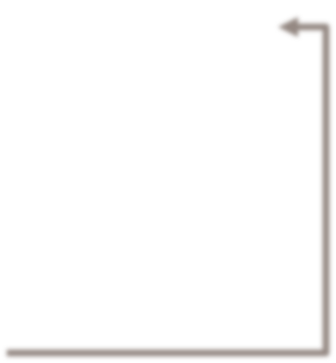



















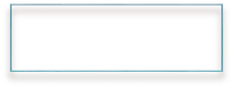




Deployment Architecture
Cisco.com Deployment
CDN
www.cisco.com External GSS/DNS
Active-Active with DR
dc1.cisco.com
dc2.cisco.com
dr.cisco.com
DMZ
Load Balancers at Web & App Tiers
6 core X 32G Apache
2.2 4TB NAS for shared htdocs
6 core X 32G Apache
2.2 4TB NAS for shared htdocs
6 core X 32G Apache
2.2 4TB NAS for shared htdocs
Identical Publish Instances
lb1
lb2
lb3
Protected Net
8 core X 32G AEM 6.0
4TB SAN for datastore 1TB SAN for segmentstore
8 core X 32G AEM 6.0
4TB NAS for datastore 1TB SAN for segmentstore
8 core X 32G AEM 6.0
4TB NAS for datastore/host 1TB SAN for segmentstore
8 core X 32G AEM 6.0
4TB NAS for datastore/host 1TB SAN for segmentstore
Mu^{lb1}ltiple Level^{lb}s² of Cach^{lb3}ing
content replication to all DC
Internal Net
Sharding of Author Instances
RCDN
author.cisco.com Internal GSS/DNS
2 core X 16G Apache
2.2 2TB NAS for
shared htdocs
lb
DC1
DC2
DR
Three Availability Zones; Two Regions

Slide 29



Architecture - Decisions Deep Dive
 | Decision Point | Options
 | Virtual/Physical | All Virtuals | All Physicals | ✓Hybrid |Cloud
 | OS | Linux | Windows
 | Storage | Attached |✓SAN|✓ NAS
 | Dispatcher@Author | Yes | No
 | LB @ Publish | Yes (n:n) | No (1:1)
 | HA: DR, Multi-DC | Single DC/✓Multi DC, DR:✓Yes|No, CDN : ✓Yes|No
 | Caching | CDN, ✓Custom Dispatcher Cache, ✓Custom App cache
 | Preview Lifecycle | Yes | ✓No
 | MicoKernel | TarMK | MongoMK | Custom Backup/Synch
Base
Architectural
Logical

Slide 30



Migration – Legacy to AEM
Business participation is critical
Deciding what to migrate and when
SEO metric
Lift-n-shift vs. Transformation
2.7 millions
assets
281
site areas
1
framework
Combination of automated and manual activities
Optimization
Preprocessing
Creation
Verification
Activation

Slide 31








Multi-tenancy
Benefits
Realms and Microsites – Set of technologies, business process, conventions and best practices that enable and streamline multi- tenancy on a single digital platform
Integrated Metrics
Criteria
One or more page meant to function as separate entity within cisco.com
Targeting a specific audience
Not part of Cisco.com top level navigation Separate permissions for authoring
Library of templates and components to choose from
Performance, CMS, Video, Security, etc.
Global Ready
Search Optimized
Mobile
5-star Experience
Cost Effective
Digital Check-In Process

Slide 32












Globalization
Country Site Strategy
Created using AEM Multi Site Manager
Content Translation
Assets for global sites
INTL English Master
Portugese Master
Spanish Master
French Master
Chinese Master
1
Live Copy
2
3
en-us
en-au
en-nz
ja-jp
pt-pt
es-ar
fr-fr
ch-cn
en-sg
en-uk
th-th
pt-br
es-co
fr-ca
ch-tw
en-in
en-ca
vi-vn
es-cr
fr-ch
ch-hk

Slide 33
Globalization - Decisions Deep Dive
Decision | Options
Country Site Content | All pages | ✓ Selective Pages
Domain | Single Domain | Country Specific Domains
Content Structure | English→language→locale) | English→Locale) |Custom
Propagation Mechanism | Multi Site Manager |Language Copy | other
Integration Mechanism | 3rd Party | Connector | ✓ Custom
Translation | Manual| ✓Automated | ✓Hybrid(MTPE)
Source | Blueprint | Existing branch or Page
Rollout Configuration | Manual | ✓Auto

Slide 34


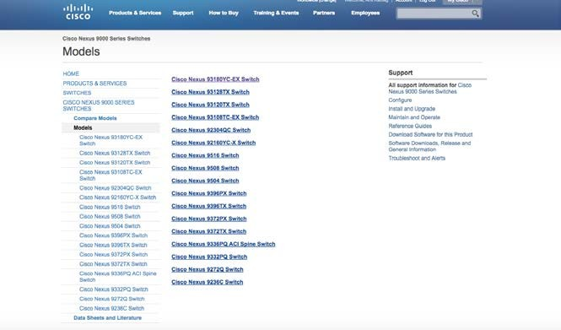


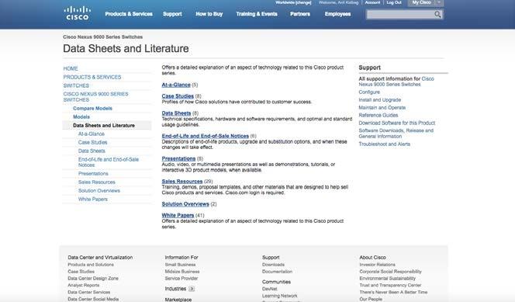



Dynamic Pages
Listing pages dynamically generated
Query based on Concept & Doctype
Reduces workload for Authors
Changes in product hierarchy immediately reflected on website
Impacts Sharding of Author Instances

Slide 35


Comparative analysis
Anshul Chhabra & Anil Kalbag
8-30-2016
© 2016 Adobe Systems Incorporated. All Rights Reserved. Adobe Confidential.

Slide 36












Architecture Decision Table Deep Dive
Decision Point Options
Virtual/Physical All Virtuals| All Physicals | ✓Hybrid|Cloud
Base
OS ✓Linux | Windows
Storage Attached | ✓SAN|✓ NAS Dispatcher@Author ✓Yes | No
LB @ Publish ✓Yes (n:n) | o (1:1)
Scalability: Physicals with
attaLchineudxs–tomraog_{M}ree_{o}fpr_{s}er_{t}eq_{c}vu_{o}ae_{m}lne_{p}tnl_{a}ty_{nies}
_{pr}A_{ef}u_{e}t_{r}h_{re}o_{dc}r:_{hf}A_{o}t_{ic}t_{A}a_{e}c_{.u}h_{th}ed_{o}/_{r}SAN
Perform_{Pu}a_{b}n_{l}c_{is}e_{h}&_{: S}uA_{A}sue_{N}tha_{/N}lol_{A}rth_{S}ree
Architectural
Maximco_{D}inz_{y}ec_{n}u_{a}Rr_{m}eres_{i}ni_{c}lic_{P}eyn_{a}. _{g}c_{e}y_{s}V, s
N
Increase_{ca}ca_{ch}ch_{e}e_{ab}c_{i}l_{l}e_{it}a_{y}r.ing
HA: DR, Multi-DC Single DC/ ✓Multi DC, DR:
CDN : ✓Yes|No
✓Y
^{es}c^{|N}om^{o,} plexity
Caching ✓CDN, ✓Custom Dispatcher Cache,
Custom App cache
External preview capability
Logical
Author Scalability.
Preview Lifecycle Yes | ✓No
MicoKernel ✓TarMK | MongoMK | Custom Backup/Synch
36

Slide 37



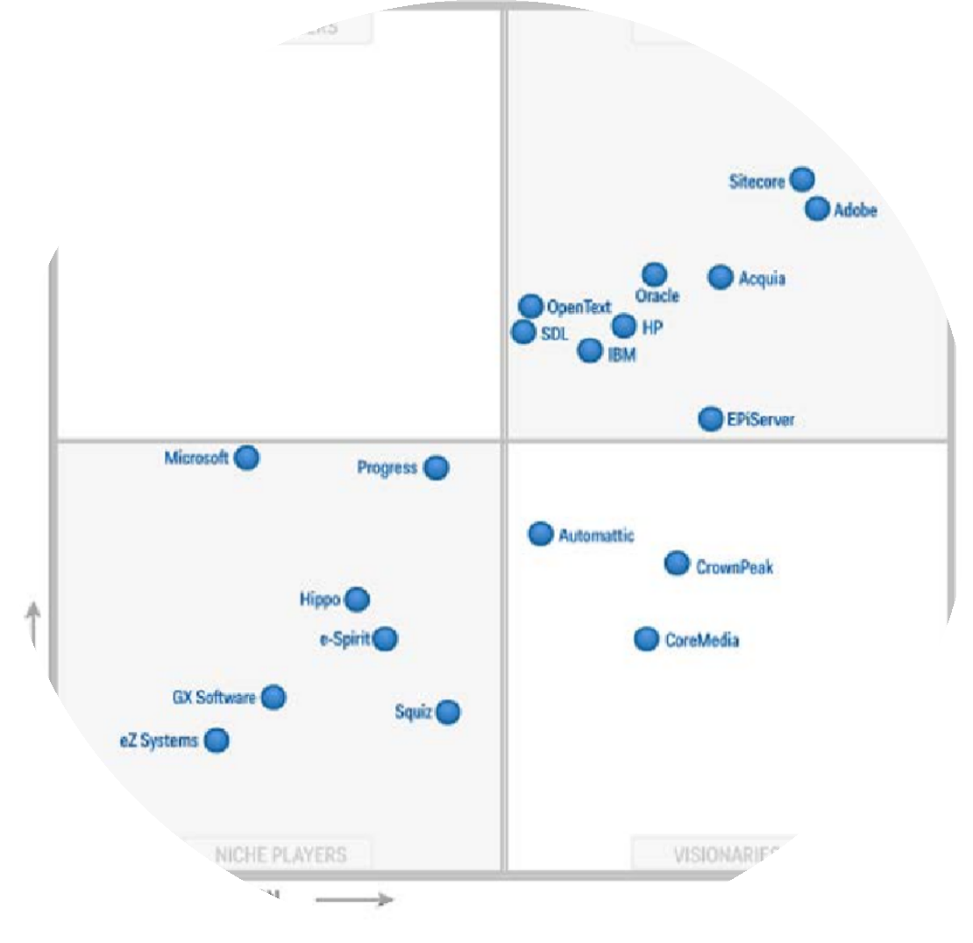
WHY MULTI TENANCY
Caching
High Availability
Best Practices for maintenance/monitoring
Product Upgrades/Patches
Leverage Architecture
Adobe is a leader in Web Content Mgmt Space
Cross utilization of AEM expertise across projects
Reduce intra-company competition for resources in marketplace
Retain good resources by giving them varied challenges
Leverage Expertise
Coordinated engagement
Influence Product Roadmap
Maximize ROI
Get our patches prioritized
Leverage Adobe
37

Slide 38



































Multi Tenancy Comparison
Separate instance For every team
One Uber instance Shared by all
Request Flow
Request Flow
Request Flow
Akamai – Caching/Acceleration
Request Flow
Authors
AEM Publish Farm – Data center 1
AEM Publish Farm – Data center 2
AEM Author Pair
Akamai – Caching/Acceleration
Akamai – Caching/Acceleration
Authors
AEM Publish Farm – Data center 1
AEM Publish Farm – Data center 2
AEM Author Pair
Akamai – Caching/Acceleration
Authors
AEM Publish Farm – Data center 1
Authors
AEM Publish Farm – Data center 1
Visitors
Visitors
Visitors
Visitors
AEM Author Pair
AEM Publish Farm – Data center 2
AEM Author Pair
AEM Publish Farm – Data center 2
Maximize Re-use
Maximize Tactical Agility & Isolation
38

Slide 39
AEM as a Service
SaaS
Templates and Components reused
All integrations are taken care of
Recommended
PaaS
AEM Container upgrades/maintenance/patches are provided
Framework/Architecture elements reused
IaaS
Only Infrastructure (not AEM specific)
© 2016 Adobe Systems Incorporated. All Rights Reserved. Adobe Confidential.
29
Copyright © 2014 Symantec Corporation

Slide 40
AEM Architecture Anti Patterns
Over Customization
Everything is a nail – when AEM is the hammer
AEM as a Façade
AEM as THE Application Engine
Taking every “sold” feature on its face value
AEM – Target integration
Continuing to use AEM classic UI over touch
Not planning for continued investment in AEM (and other Adobe) Products & resources
Includes investment in a tight well organized team
Investment of time in building a good relationship in Adobe & community
40

Slide 41
AEM in the cloud
Most installations so far are on prem – or not completely cloud native.
Future – looks different – more and more push to Cloud.
Multiple options going forward
AEM Managed Services (AWS MarketPlace)
Azure Virtual Machine (BYOL) – on windows
Rackspace – complete with full suggested deployment architectures
Need Adobe Product to evolve more also:
More Cloud Native offerings
Support for MicroServices & Continuous Integration& Delivery
Better Support for Multi Tenancy in same instance
41

Slide 42
Wishlist from Adobe
Improved Integrations – eg: Target, Segments (Audience Mgr), eCommerce
Better Support and penetration in Cloud
More Cloud Native offerings
Support for MicroServices & Continuous Integration& Delivery
Better Support for Multi Tenancy in same instance
More robust and scalable repository
Improved support for Active Passive Mode, Backups, Maintenance activities
Improved content transfer capability from Prod to Non-Prod
42

Slide 43
Introduction
AEM Workflows
AEM Workflows let you execute individual steps in a sequential order
AEM Workflows offer a variety of ways in which to mix automatic steps and human interactions.
They offer conditional execution and parallel execution.
You can pass data from one to step to another step.
You can pass data when you invoke the workflow.
You can invoke a workflow using Workflow Launcher
You can invoke a workflow using AEM APIs
AEM offers a number of out of the box workflow steps.
AEM lets you create a custom workflow to meet your business requirements

Slide 44
Agenda
Create a new workflow that activate AEM pages
How to invoke the workflow
How to check if the workflow is successful
How to invoke a workflow using workflow Launcher
How to create a custom workflow step
Types of workflow steps you can create
Managing data in your workflow
Monitor performance of workflows
Managing workflow throughput
Workflow Maintenance
Q/A

Slide 45
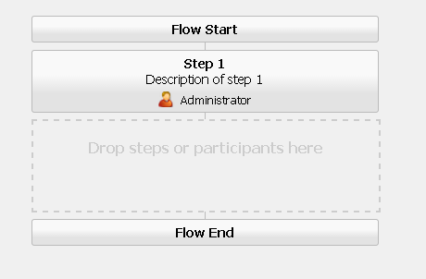
Create a New Workflow
To create a new workflow:
Navigate to the workflow console: http://localhost:4502/libs/cq/workflow/content/console.html.
Click the New button that is located on the upper left side of the page.
Enter the title AEMExperts and then click OK.
Double click the workflow to view the model.

Slide 46
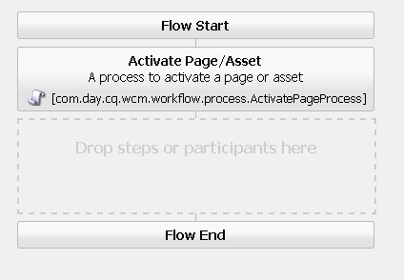
Create a New Workflow (continued)
Because we are making an automated workflow (no human interaction), delete 1st step.
Under the WCM Workflow section in sidekick, select Activate Page / Assets.
Click the Save button.
The new workflow should look like:

Slide 47
DEMO (Create the new workflow)
Build the AEMExperts Worflow

Slide 48
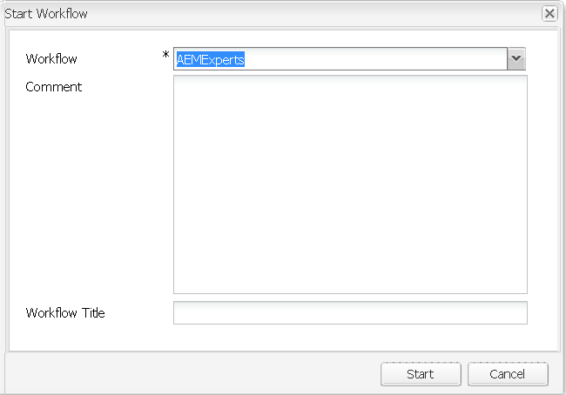
Invoke the Workflow
You can publish a page by invoking the AEMExperts workflow. To demonstrate, we will
make a change to the page located at:
http://localhost:4502/cf#/content/geometrixx/en/products/triangle.html
For simplicity, we will underline some text in the triangle.html page.
Once you make the changes and ready to publish the page, you can use the newly created workflow.

Slide 49
DEMO (Manually invoke the new workflow)
Manually invoke the AEMExperts Worflow

Slide 50
Using Workflow Launcher
Workflow launcher lets you automatically invoke a workflow based on conditions.
Conditions are based on changes to content located in the AEM JCR. For example – when a page is modified.
In this example, Workflow launcher is configured to invoke a workflow when content under /content/geometrixx is modified. The result is the AEMExperts workflow automatically published the page.

Slide 51
To configure Workflow Launcher to invoke a workflow:
Configure Workflow Launcher
Go to workflow console at http://localhost:4502/libs/cq/workflow/content/console.html.
Click the Launcher tab.
Click the Add button at the top left of the page.

Slide 52
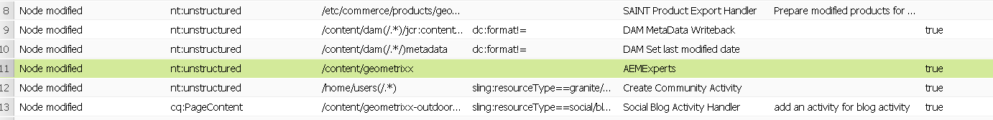
4. Add the following information:
Configure Workflow Launcher (continued)
Event Type: modified
Node Type: nt:unstructured
Path: /content/Geometrixx
Workflow: AEMExperts
Description: Activates Geometrixx pages
Activate: leaved enabled
Exclude List: Leave empty
Run Mode(s): Author
5. Click OK.

Slide 53
DEMO
Configure Workflow Launcher

Slide 54
Creating a Custom Workflow Step using the Workflow API
You can create an AEM custom workflow step by using AEM Workflow APIs located in the com.adobe.granite.workflow.exec package.
A custom AEM Workflow step is implemented as a service within an OSGi bundle.
A custom Workflow step can be placed into a workflow model like out of the box steps.
This example creates a custom Workflow step that sends email messages.
To send email messages within a custom workflow step, you can use a
com.day.cq.mailer.MessageGateway instance.

Slide 55
DEMO (live coding)
Show How To create a custom workflow step

Slide 56
Types of Workflow Steps you can create
Process Step
Implement com.adobe.granite.workflow.exec.WorkflowProcess
Execute and complete
Auto-Advance
External Process Step
Implement com.adobe.granite.workflow.exec.ExternalWorkflowProcess
Primary use is calling another system, and waiting for response
Workflow engine polls your step for completion
Implement
execute()
hasFinished()
handleResult()

Slide 57
When do I save the session?
Acquire JCR session from workflow session
Granite WorkflowSession:
session = workflowSession.adaptTo(javax.jcr.Session.class);
CQ WorkflowSession (will be deprecated at some point)
session = workflowSession.getSession();
Use this session to process the payload – don’t acquire your own.
But…….
Do not save this session!
Workflow Engine saves session for you when required
More efficient and better error handling if you let the workflow engine save session
Engine attempts to run as many steps together at one time as possible

Slide 58
Managing data in your workflow
Payload
Typically a path in the repository
You can add status or other data associated with payload (ex: DAM Update Asset)
WorkItem metadata
Can store information related to an individual step
Most useful for steps which do not complete immediately (participant step, external process)
Workflow metadata
Useful for populating when a workflow starts, and sharing amongst different workflow steps
Can be updated in a step:
workItem.getWorkflowData().getMetaDataMap().put(“someKey”, “someValue”);
Can be retrieved on subsequent steps:
workItem.getWorkflowData().getMetaDataMap().get(“someKey”, String.class);

Slide 59
Behind the scenes…
WebDav upload of assets
Worklfow Engine processes
More Jobs are scheduled
as many steps as possible
and processed as needed
Workflow Launcher starts
Workflow engine is not
workflow from JCR Node
ified to process job
Workflow is finished
Added Event
Workflow Engine
creates Sling Job to process worklfow
Sling Job Queue has a job to execute!

Slide 60
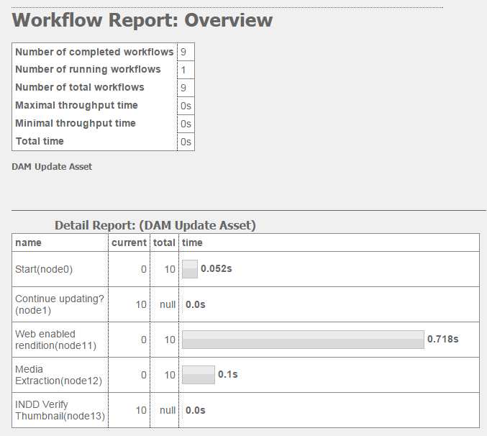
Monitor performance of workflows
Workflow Stats http://localhost:4502/etc/reports/workflowreport.html
Details on number of workflows and duration
Links with breakdowns for individual workflows
Individual steps (grouped) are timed
Execution optimized, which skews results slightly

Slide 61
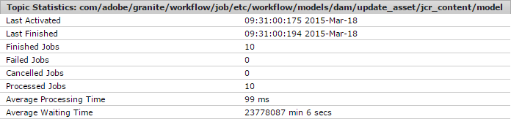
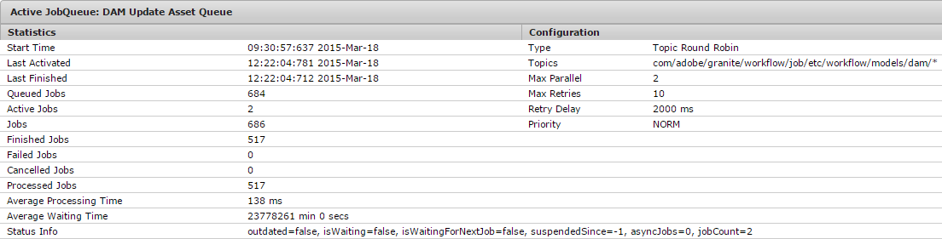
Monitor performance of workflows - continued
Sling Jobs Page http://localhost:4502/system/console/slingevent
Monitors what has happened
Monitors what is happening

Slide 62
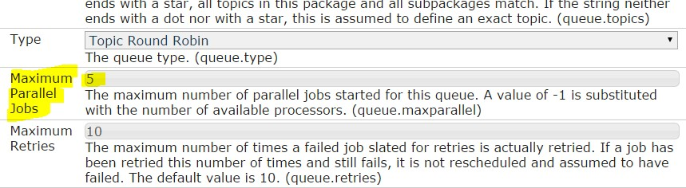
Managing Workflow Throughput
Can limit number of threads used to execute worklfows
This can be configured globally for entire system, or per workflow
Globally: edit “Granite Workflow Queue”
Per workflow: create new Sling Job Queue
Edit “maximum parallel jobs”

Slide 63
Managing Workflow Throughput - DEMO
Show how to create a Sling Job Queue for a specific workflow
see documentation:
http://docs.adobe.com/docs/en/aem/6-0/deploy/configuring/performance.html#Concurrent Workflow Processing

Slide 64
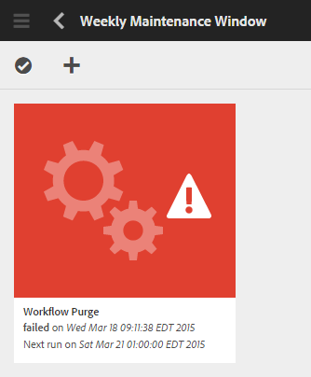
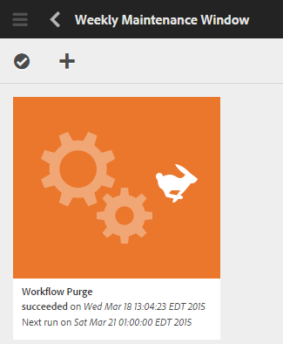
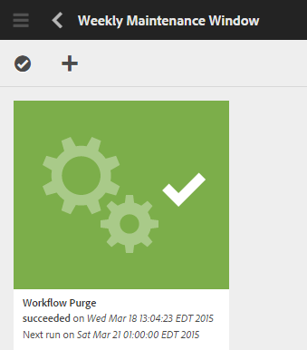
Workflow Maintenance
Workflow Purge
It’s important! Clean old workflow instances from system
Configure weekly maintenance window
Stale Workflows
a running workflow no longer has a job in system
Workflows can be safely restarted in workflow console or jmx
Helpful utilities in Workflow Maintenance JMX bean:
http://localhost:4502/system/console/jmx/com.adobe.granite.workflow%3Atype%3DMaintenance

Slide 65
1. Workflows
AGENDA
Workflow API
Custom Workflow Service
Demo
Take Care
Best Practices
Open Discussion
AGENDA

Slide 66
WORKFLOWS
WORKFLOW

Slide 67
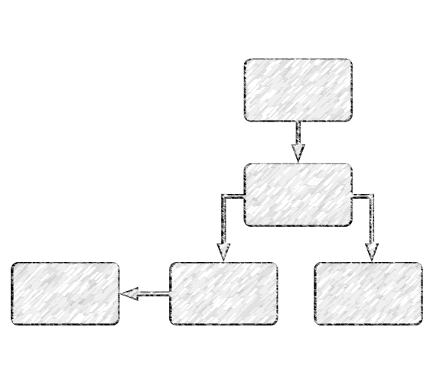
WORKFLOW
“the sequence of processes through which a piece of work passes from initiation
to completion”
WORKFLOW
Workflows enable you to automate activities with Adobe Experience Manager.
Workflows consist of a series of steps that are executed in a specific
order.
Each step performs a distinct activity based on the type of step and input

Slide 68
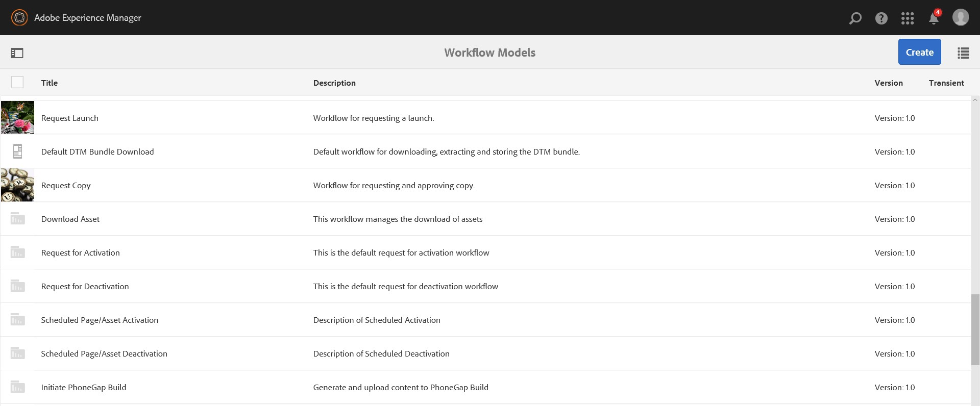
WORKFLOW
You can have conditional execution and/or parallel execution
Pass data from one step to another step
Adobe Experience Manager offers many ‘Out of the Box’ workflows
http://localhost:8080/libs/cq/workflow/content/console.html
Adobe Experience Manager lets you create a custom workflow based on
WORKFLOW
business requirements

Slide 69
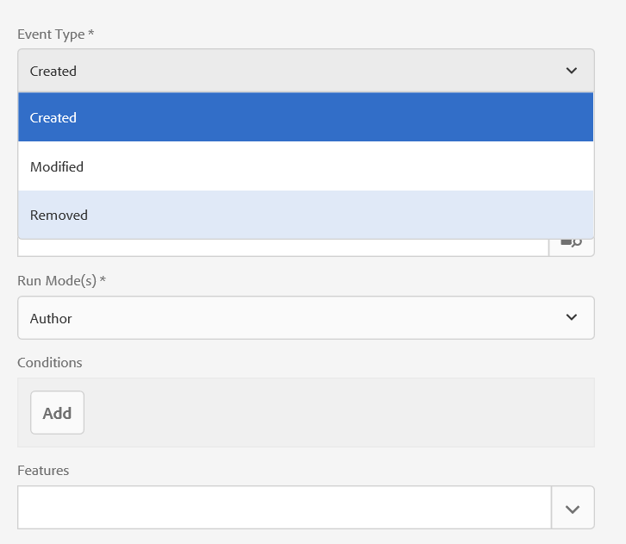
INVOCATION
Manual
Launcher
JCR Event Based
Node Created
Node Modified
Node Removed
AEM APIs
WORKFLOW

Slide 70




WORKFLOW PILLARS
Workflow
Workflow Model
Workflow Instance
Workflow Session
Each definition of a workflow is a Workflow Model
When a workflow model is started, a workflow instance is started
Session to process the payload
WORKFLOW
Workflow is the definition, execution and automation of business processes
The steps, Flow Start and Flow End. These steps are required and cannot be edited/removed.
Series of steps with actions, according to the set of procedural rules. Edit or delete this step, and add steps as required.
Make sure all the infrastructure and environment for the production are ready.
Make all the necessary pre- configuration required.
Deploy the code and create the required content
Workflow session is used manage the complete transaction of a workflow instance
Get JCR session from the workflow session when using a custom workflow step.

Slide 71




WHAT CAN BE DONE
Process Step
Goto Step
Participant Step
A Process Step executes an ECMAScript or calls an OSGi service to perform automatic processing.
The Goto Step allows you to specify the next step in the workflow model to execute, dependent on the result of an ECMAScript: true: The Goto Step completes and the workflow engine executes the specified step. false: The Goto Step completes and the normal routing logic determines the next step to execute.
The Goto Step enables you to implement advanced routing structures in your workflow models. For example, to implement a loop, the Goto Step can be defined to execute a prior step in the workflow, with the script evaluating a loop condition.
A Participant Step enables you to assign ownership for a particular action. The workflow will only proceed when the user has manually acknowledged the step. This is used when you want someone to take an action on the workflow; for example, a review step.
the user must have access to the page that is the workflow payload.
WORKFLOW
Container Step
A container step starts another workflow model that executes as a child workflow. This container can allow you to reuse workflow models to implement common
sequences of steps. For example a translation workflow model could be used in multiple editing workflows.
Dialog Participant
Dynamic Participant
Form Participant
Random Participant

Slide 72

EXAMPLE
Publish Workflow
An editor has to review the content - before a site administrator activates the page. A workflow that automates this example notifies each participant when it is time to perform their required work
The author applies the workflow to the page.
The editor receives a work item that indicates that they are required to review the page content. When finished, they indicate that their work item is complete.
The site administrator then receives a work item that requests the activation of the page. When finished, they indicate that their work item is complete.
EXAMPLE

Slide 73
WORKFLOW API
WORKFLOW API

Slide 74
WORKFLOW APIs
com.adobe.granite.workflow.exec
com.adobe.granite.workflow.model
Interfaces
WorkflowProcess
WorkItem
WorkflowData
Workflow
ParticipantStepChooser
DynamicParticipantExecutor
Participant
HistoryItem
InboxItem
Route
ScriptContextProvider
StepExecutor
WorkflowExternalProcess
WorkflowExternalProcessProxy
Interfaces
WorkflowModel
WorkflowModelFilter
WorkflowModelSerializer
WorkflowNode
WorkflowTransition
WORKFLOW APIS
com.adobe.granite.workflow
Interfaces
WorkflowSession
HasMetaData
PayloadMap
com.adobe.granite.workflow.metadata
Interfaces
MetaDataMap

Slide 75
CUSTOM WORKFLOW SERVICE
CUSTOM WORKFLOW SERVICE

Slide 76
CUSTOM PROCESS STEP
import com.adobe.granite.workflow.WorkflowException; import com.adobe.granite.workflow.WorkflowSession;
import com.adobe.granite.workflow.exec.WorkItem; import com.adobe.granite.workflow.exec.WorkflowData; import com.adobe.granite.workflow.exec.WorkflowProcess; import com.adobe.granite.workflow.exec.WorkflowData;
import com.adobe.granite.workflow.metadata.MetaDataMap; import com.adobe.granite.workflow.model.WorkflowNode;
CUSTOM PROCESS STEP
@Component(service=WorkflowProcess.class, property = {"process.label=My Workflow Process"}) public class CustomStep implements WorkflowProcess
{
public void execute(WorkItem workItem, WorkflowSession workflowsession,MetaDataMap args) throws WorkflowException { final WorkflowData workflowData = workItem.getWorkflowData();
final String type = workflowData.getPayloadType(); if (!StringUtils.equals(type, "JCR_PATH")) {
return;
}
Session session = workflowSession.adaptTo(Session.class); final String path = workflowData.getPayload().toString();
try {
Node node = session.getNode(path);
/* Write your custom code here. */
} catch (Exception ex) {
/* Use this block for Exception Handling. */
}
}
13
}

Slide 77
CUSTOM PARTICIPANT STEP
import com.adobe.granite.workflow.WorkflowException; import com.adobe.granite.workflow.WorkflowSession;
import com.adobe.granite.workflow.exec.WorkItem; import com.adobe.granite.workflow.exec.WorkflowData; import com.adobe.granite.workflow.exec.WorkflowProcess; import com.adobe.granite.workflow.exec.WorkflowData;
import com.adobe.granite.workflow.metadata.MetaDataMap; import com.adobe.granite.workflow.model.WorkflowNode;
@Component(service= ParticipantStepChooser.class, property = {"process.label=My Participant Workflow Step"}) public class MyDynamicParticipant implements ParticipantStepChooser {
CUSTOM PRATICIPANT STEP
public String getParticipant(WorkItem workItem, WorkflowSession workflowSession, MetaDataMap args) throws WorkflowException {
WorkflowData workflowData = workItem.getWorkflowData(); if (workflowData.getPayloadType().equals(TYPE_JCR_PATH)) {
// Write your custom code here.
String path = workflowData.getPayload().toString();
String pathFromArgument = args.get("PROCESS_ARGS", String.class);
if (pathFromArgument != null && path.startsWith(pathFromArgument)) { return "admin";
}
}
return "administrators";
}
14
}

Slide 78
KEY WORKFLOW ELEMENTS
Payload
Typically a path in a repository
you can add the status or other data associated with payload (ex: DAM update Asset)
WorkItem metadata
can store info related to an individual step
most useful for steps which do not complete immediately(participant step, external process)
Workflow metadata
useful for populating when a workflow starts, and sharing amongst different workflow steps
can be updated in a step workItem.getWorkflowData().getMetaDataMap().put(“somekey”,”someValue”);
can be retrieved on subsequent steps workItem.getWorkflowData().getMetaDataMap().get(“somekey”,String.class);
KEY WORKFLOW ELEMENTS

Slide 79
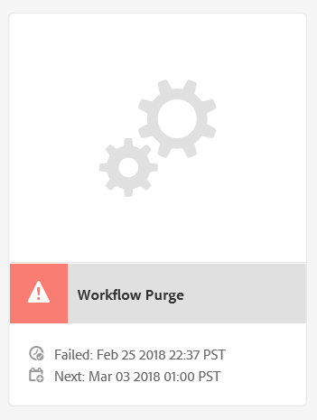
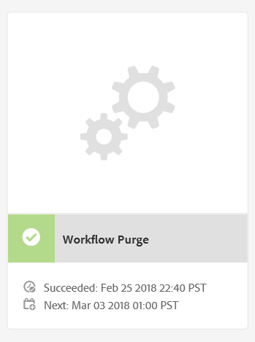
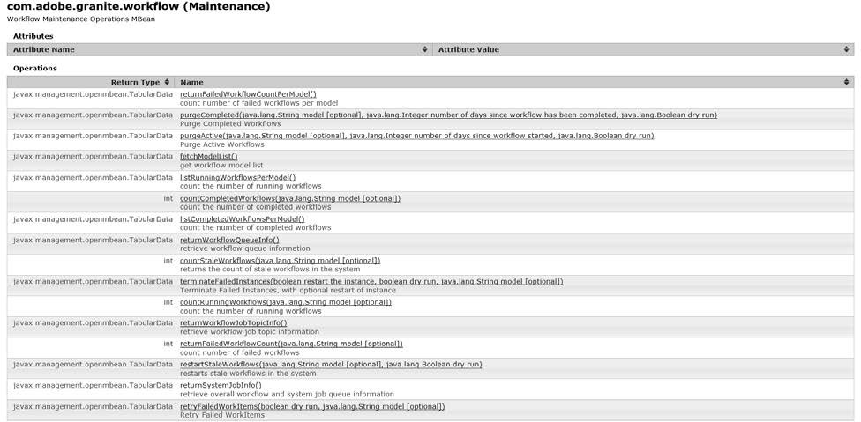
WORKFLOW MAINTENANCE
WORKFLOW PURGE
It’s important! To clean old workflow instances from the system
Clean up completed and aborted workflows on a regular basis.
Configure Weekly maintenance window
STALE WORKFLOWS
A running workflow no longer has a job
Workflow can be safely restarted in workflow console or jmx
WORKFLOW MAINTENENCE
SYSTEM CONSOLE
http://localhost:8080/system/console/jmx/com.adobe.granite.workfl ow%3Atype%3DMaintenance
http://localhost:8080/system/console/slingevent

Slide 80
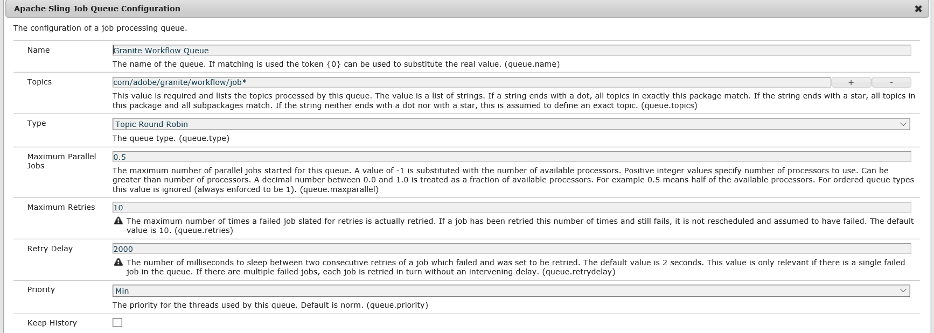
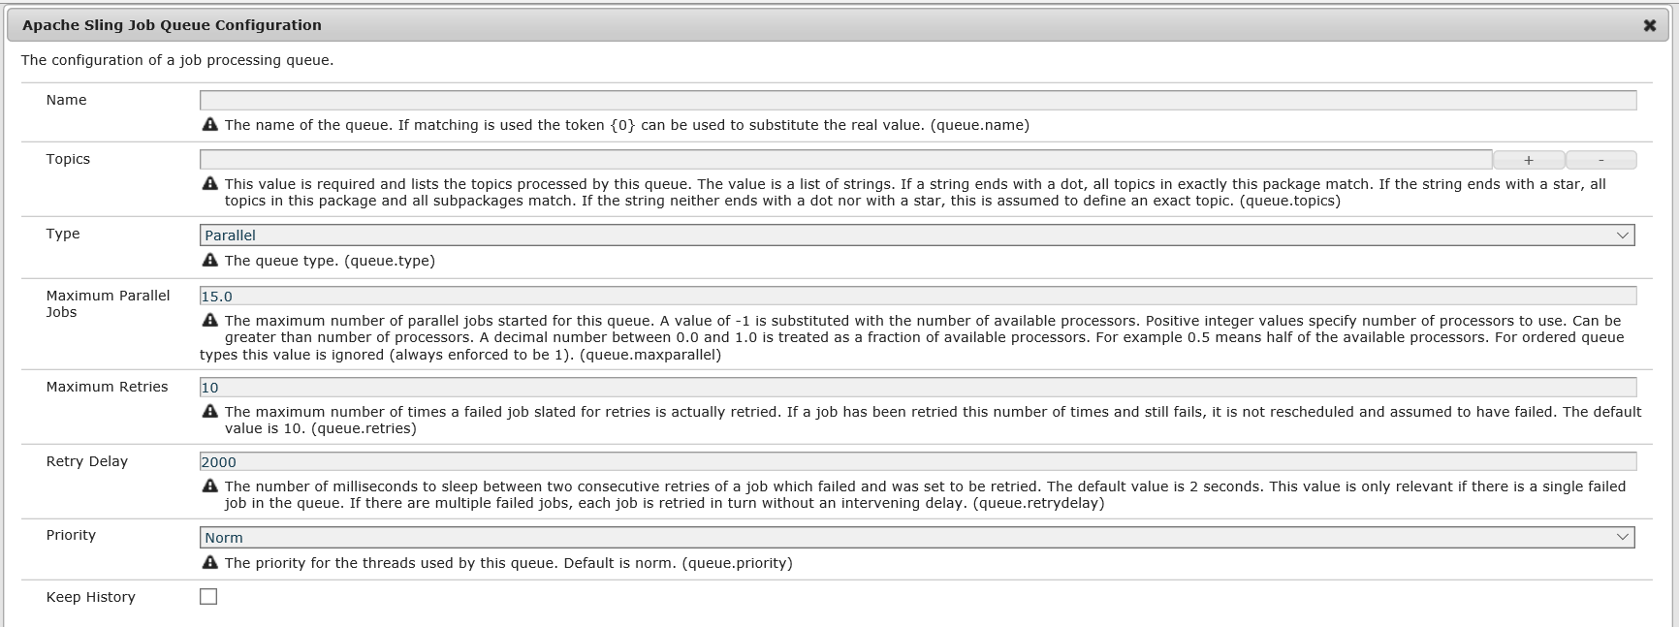
WORKFLOW THROUGHPUT
Limit number of threads used to execute workflows.
OOB its set to half the number of CPU cores and its not advised to change it
Can be configured per workflow or globally
GLOBALLY
Edit : ‘Granite Workflow Queue’
WORKFLOW THROUGHPUT
PER WORKFLOW
Create new Sling job queue

Slide 81
BEST PRACTICES
BEST PRACTICES

Slide 82
BEST PRACTICES
Transient Workflows
The runtime data related to the intermediate worksteps and also the trance of the workflow(if success) are not persisted in the JCR when they run
Transient workflows become persistent workflow
if an error occurs
Participant step or external process step is used Advantages
A reduction in the workflow processing time.
Significantly reduce repository growth.
No more CRUD workflows are required to purge.
In addition, it reduces the number of TAR files to compact.
Maintenance and Monitor
Do not forget to setup workflow purging and monitor for stale workflows.
ARCHITECTURE REVIEW
Sessions
The WorkflowSession can be adapted to either a JCR session or a Sling ResourceResolver. It is a best practice to use this adapt pattern to make changes to the payload instead of acquiring your own JCR Session or Resource resolver.
Creating a new sessions can result in parallel workflows colliding on the same payload.
Do not save this session.
Workflow will save the session when required
Workflow engine attempts to run as many steps together at one time as possible
Better and Efficient error handling
General
Do not edit any out of the box workflows or launchers. Always clone the model and edit as necessary. ‘Override’ function is introduced in AEM 6.4 to address this.
21

Slide 83
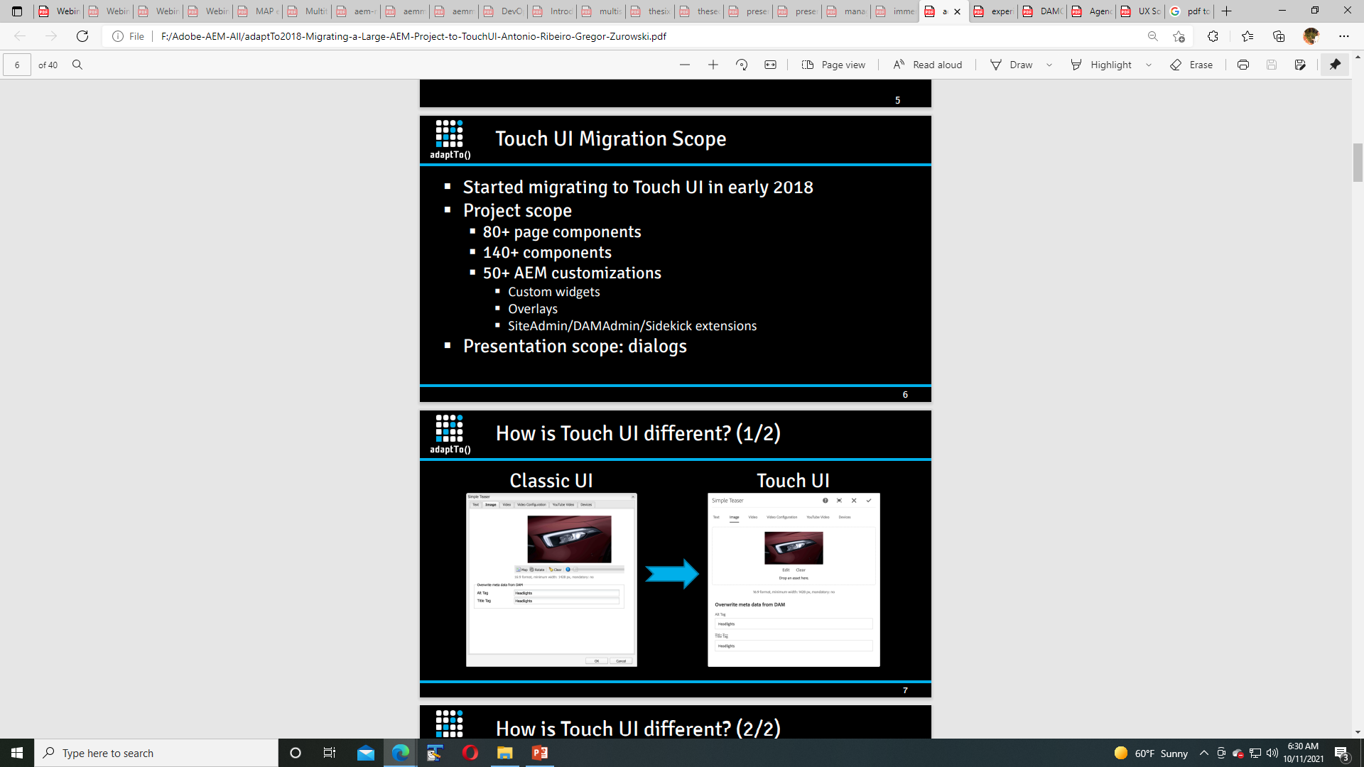

Slide 84
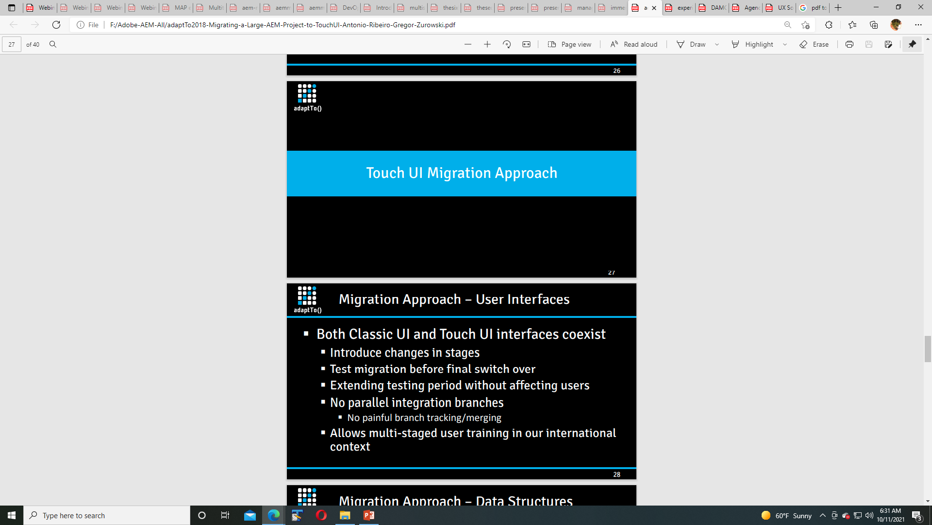

Slide 85
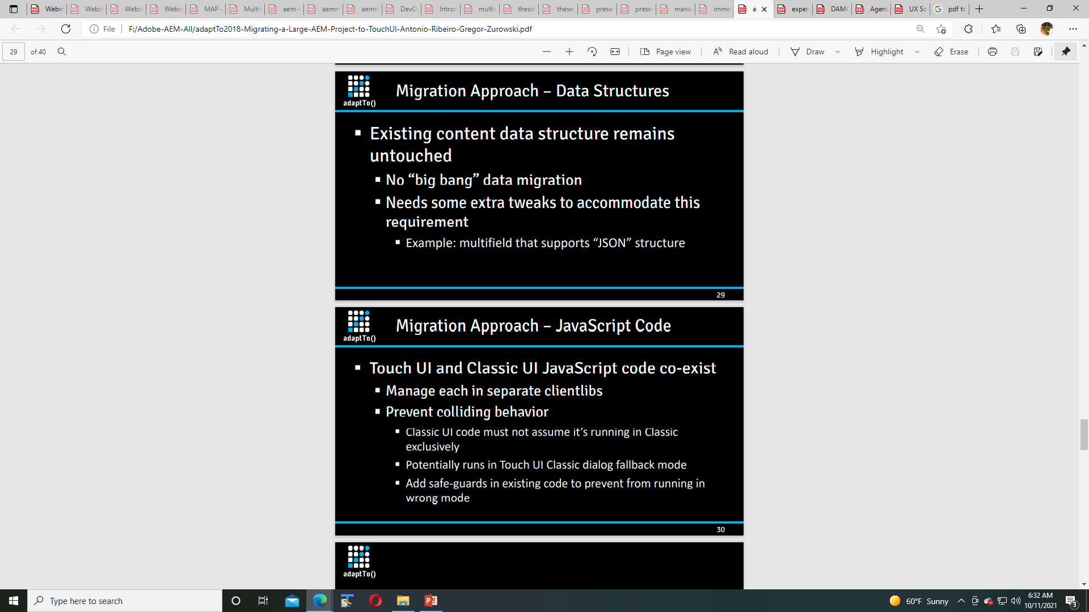

Slide 86
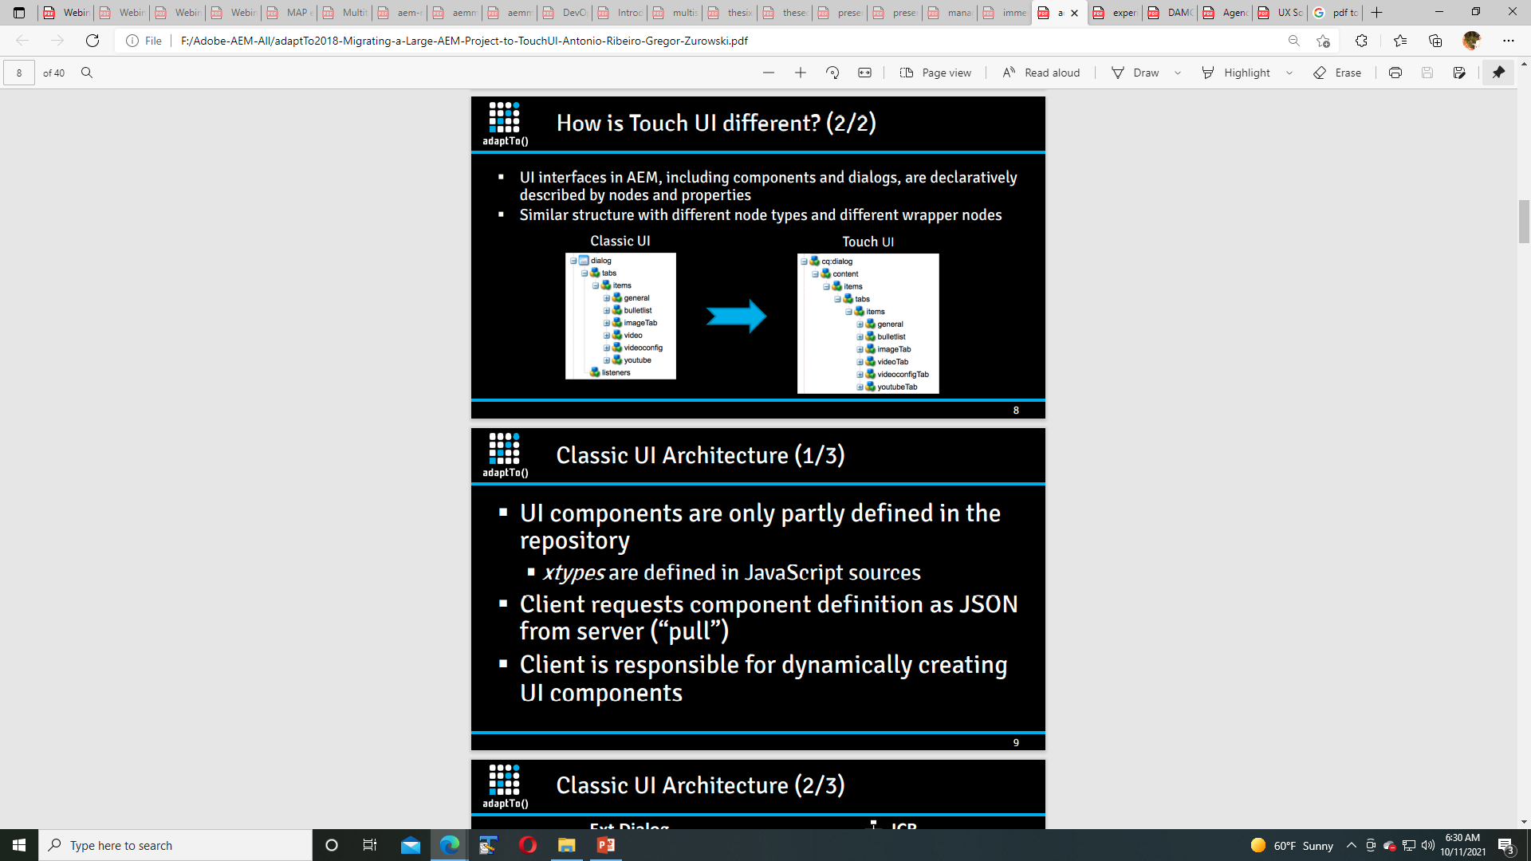

Slide 87
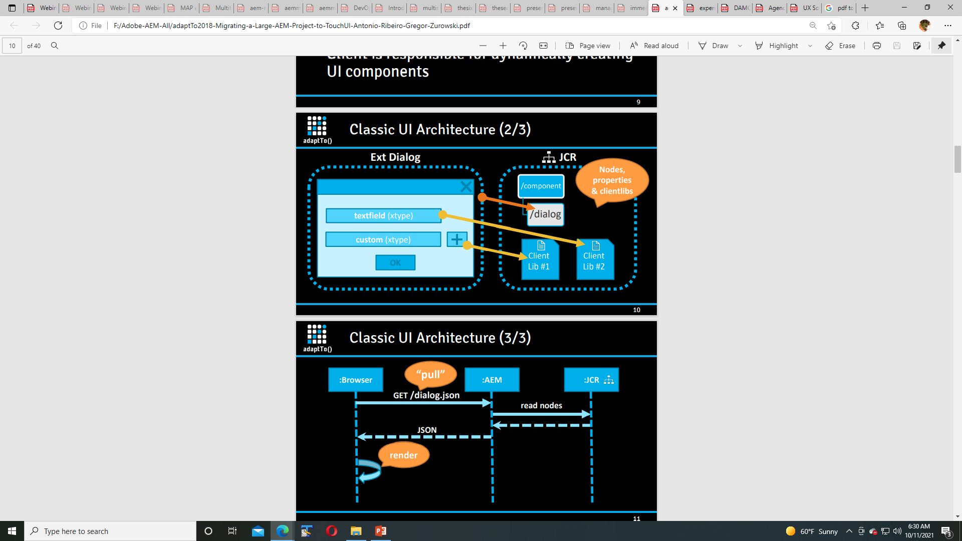

Slide 88
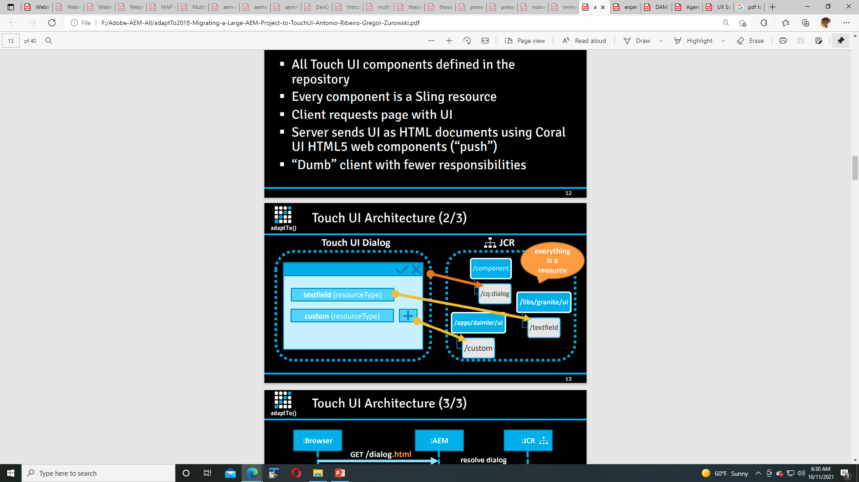

Slide 89
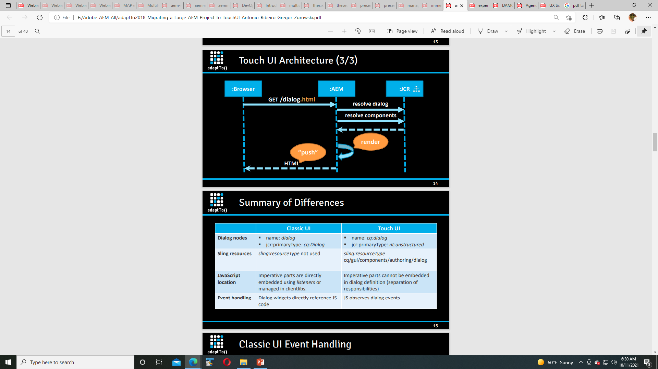

Slide 90
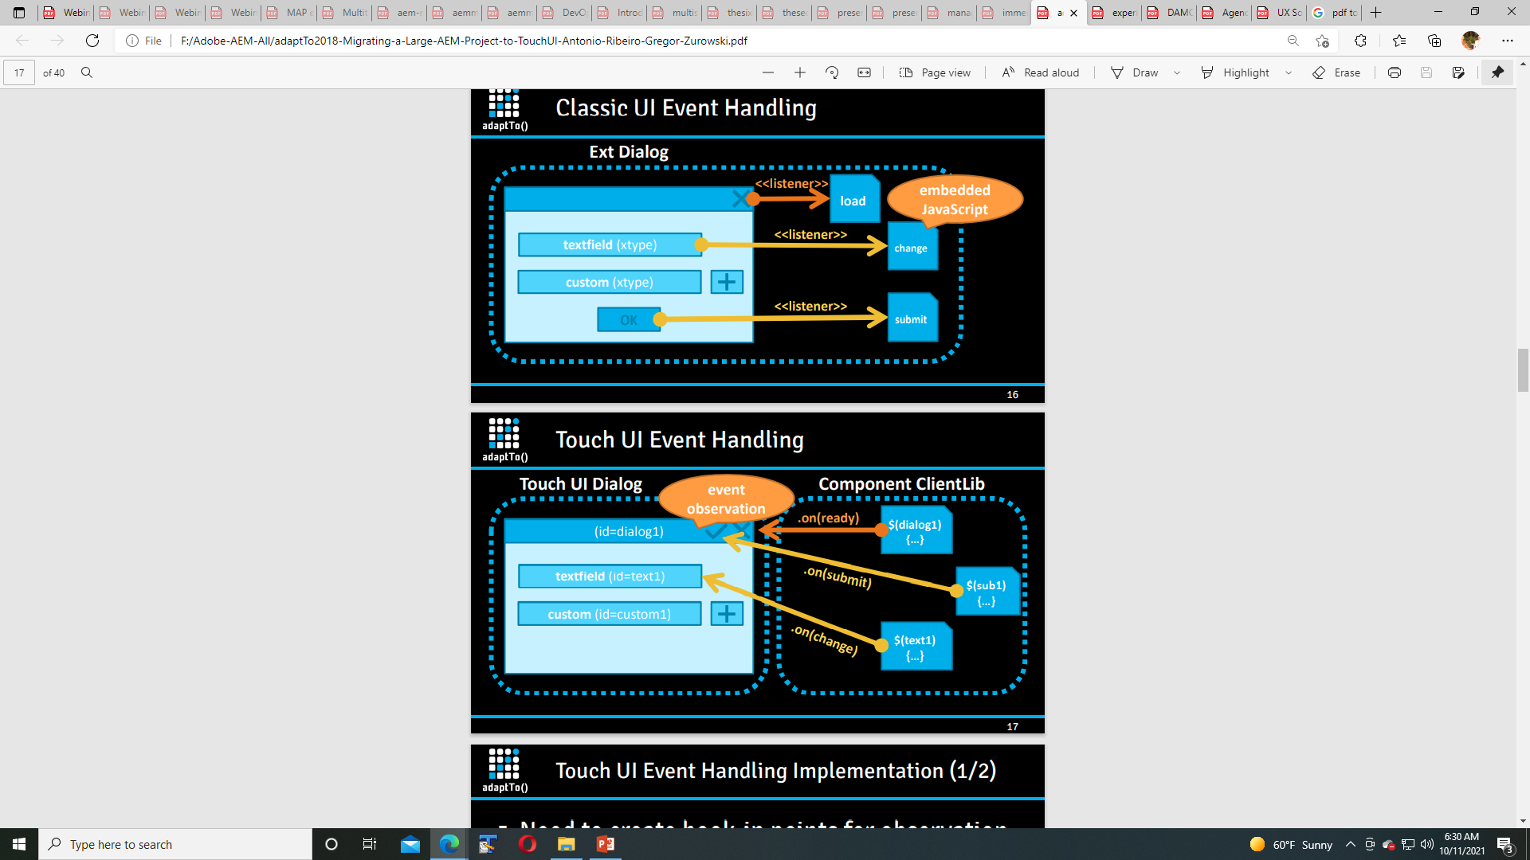

Slide 91
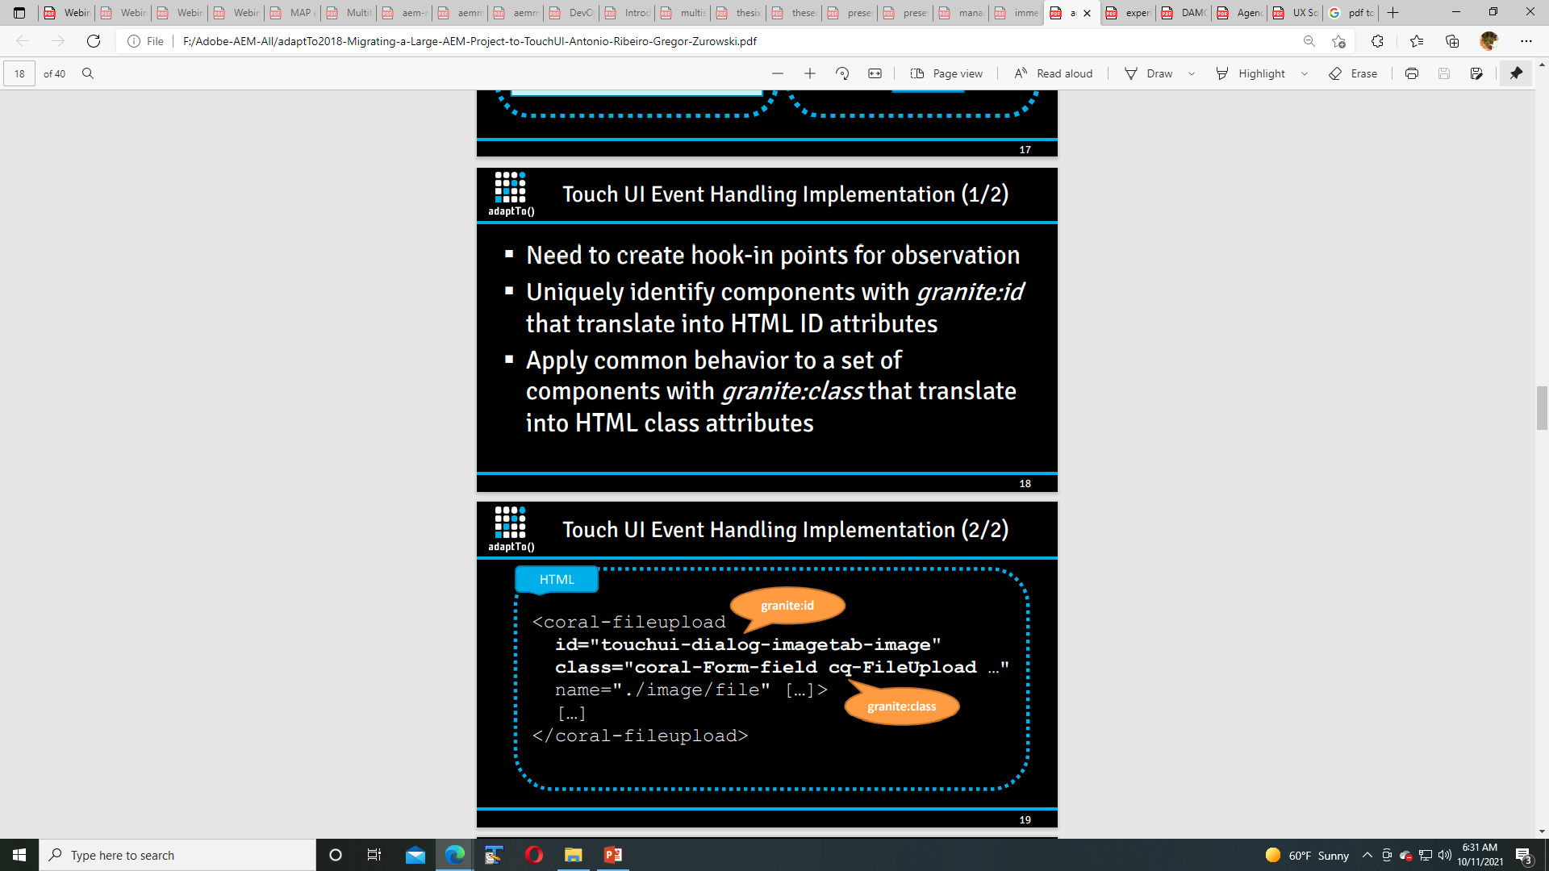

Slide 92
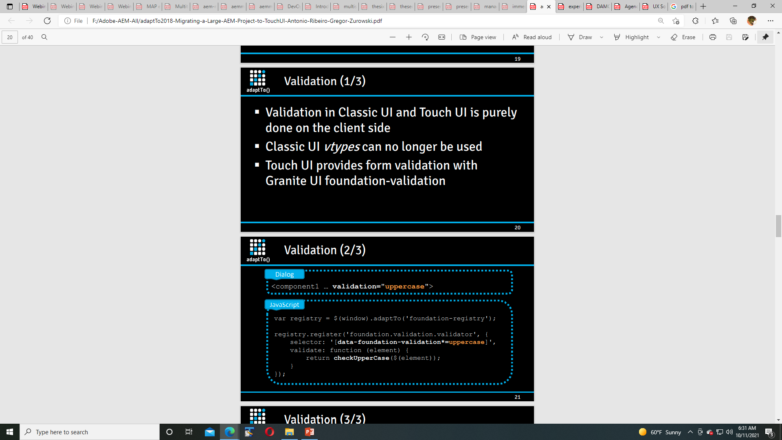

Slide 93
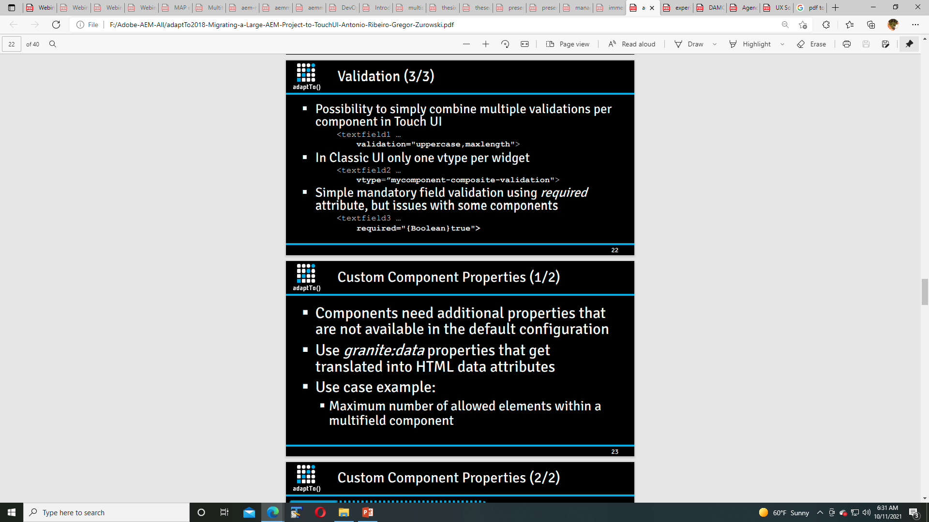

Slide 94
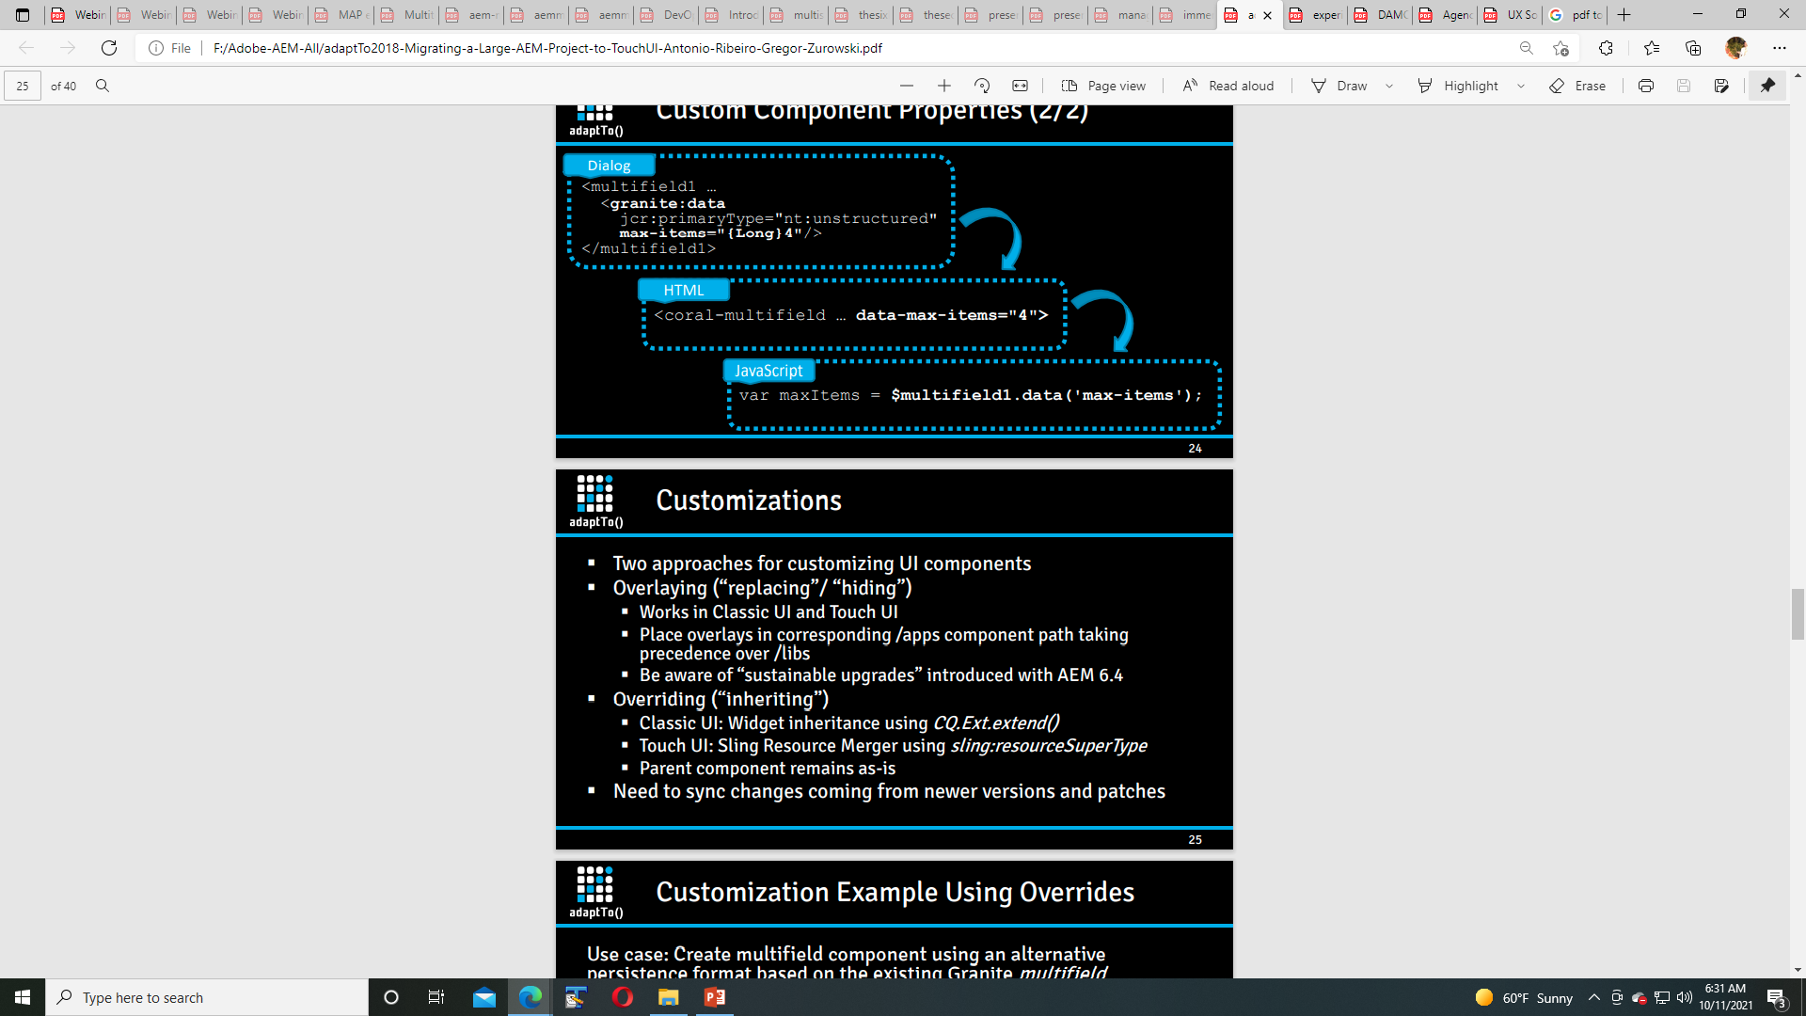

Slide 95
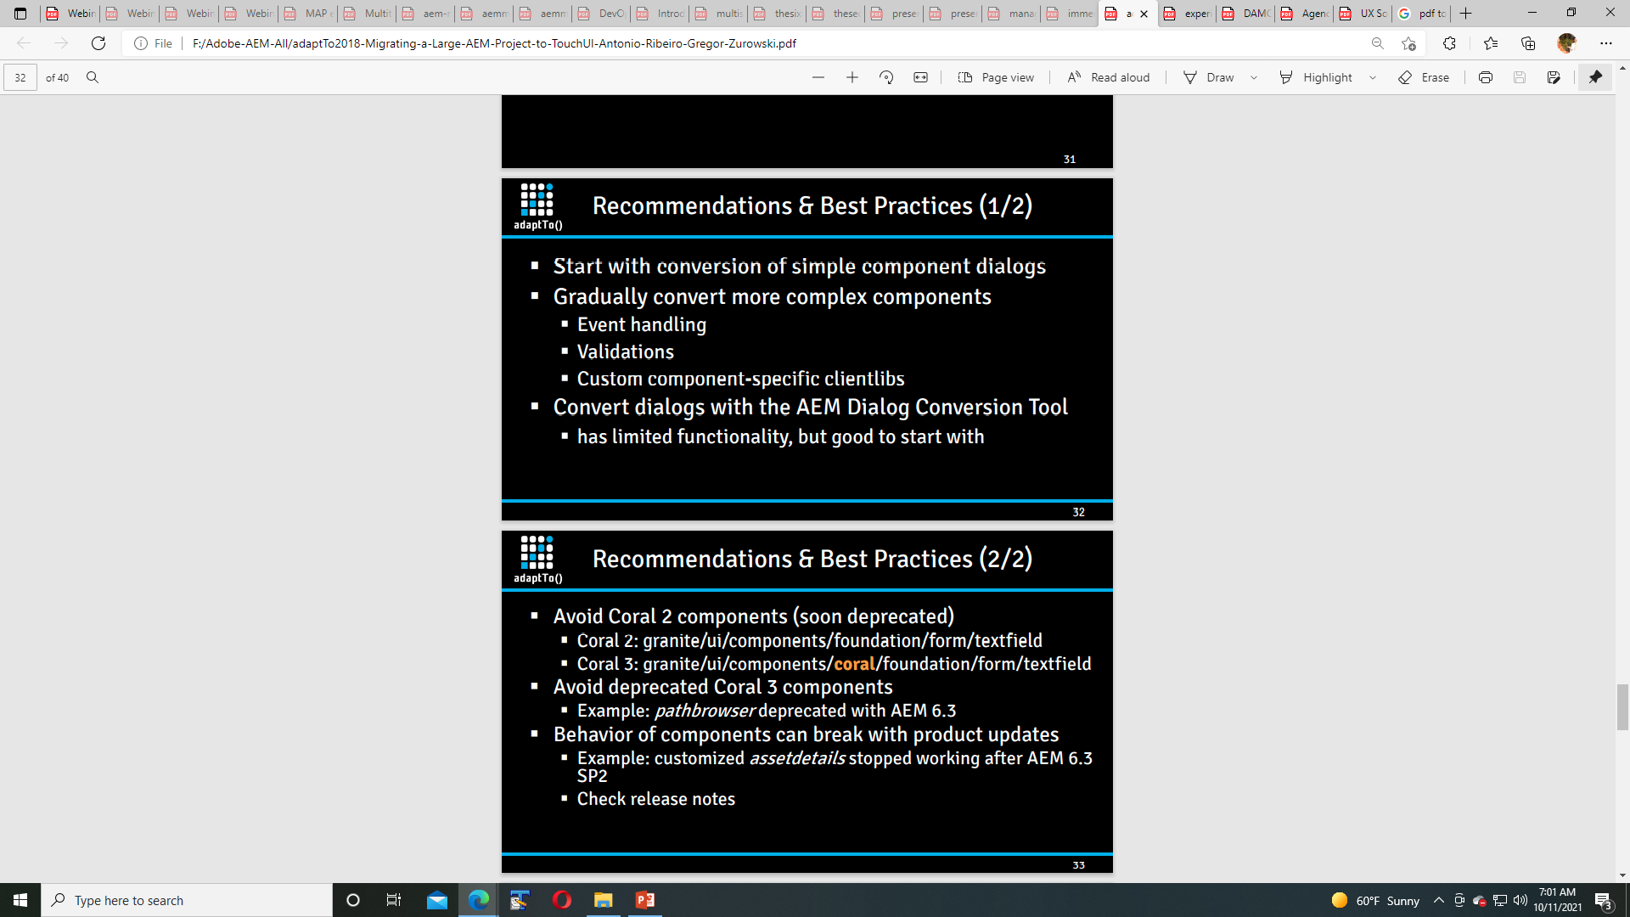

Slide 96
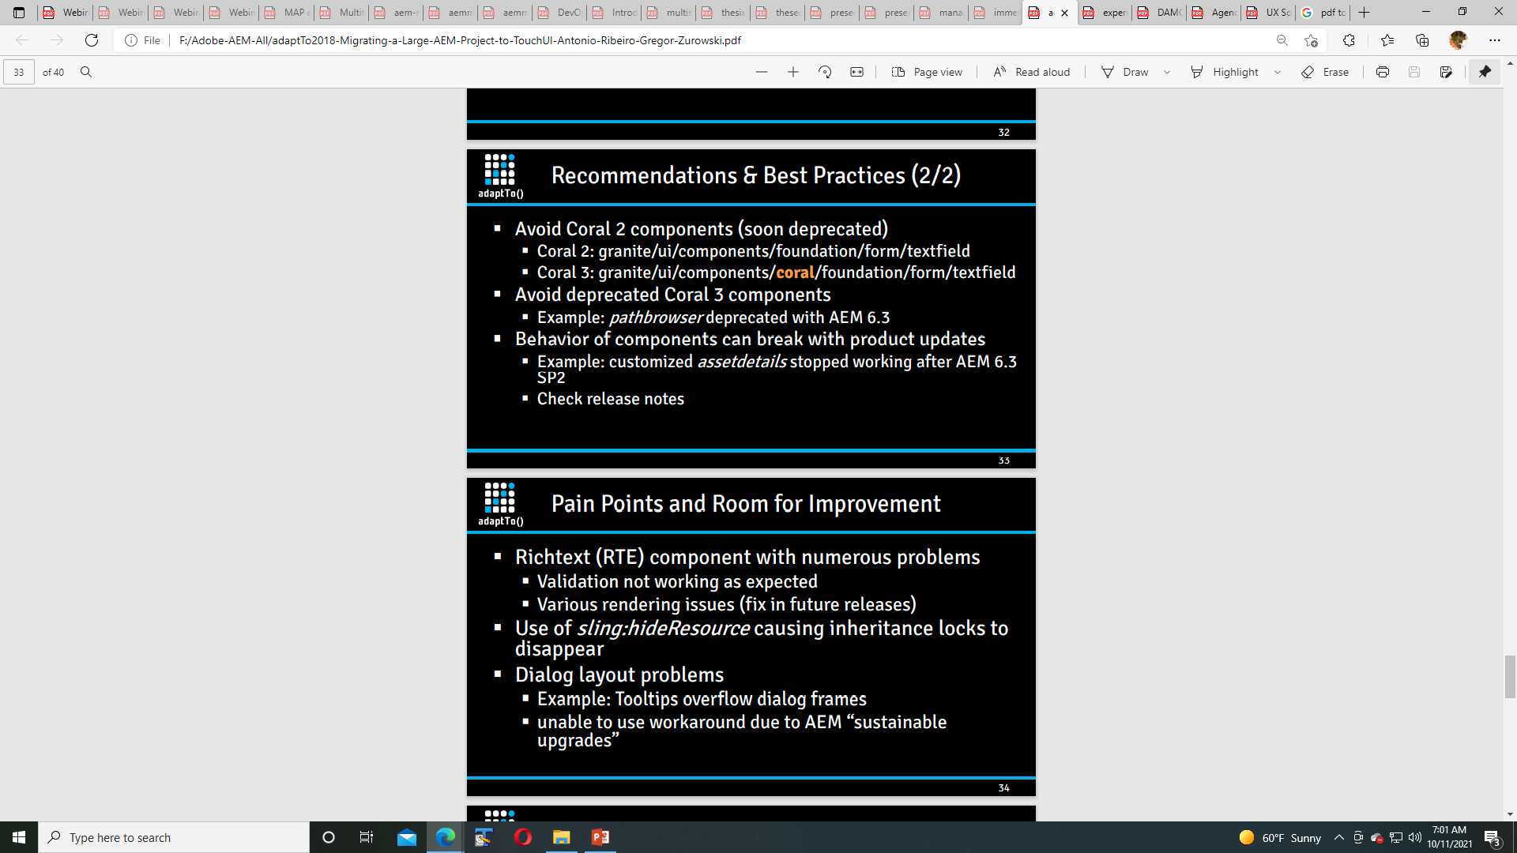

Slide 97
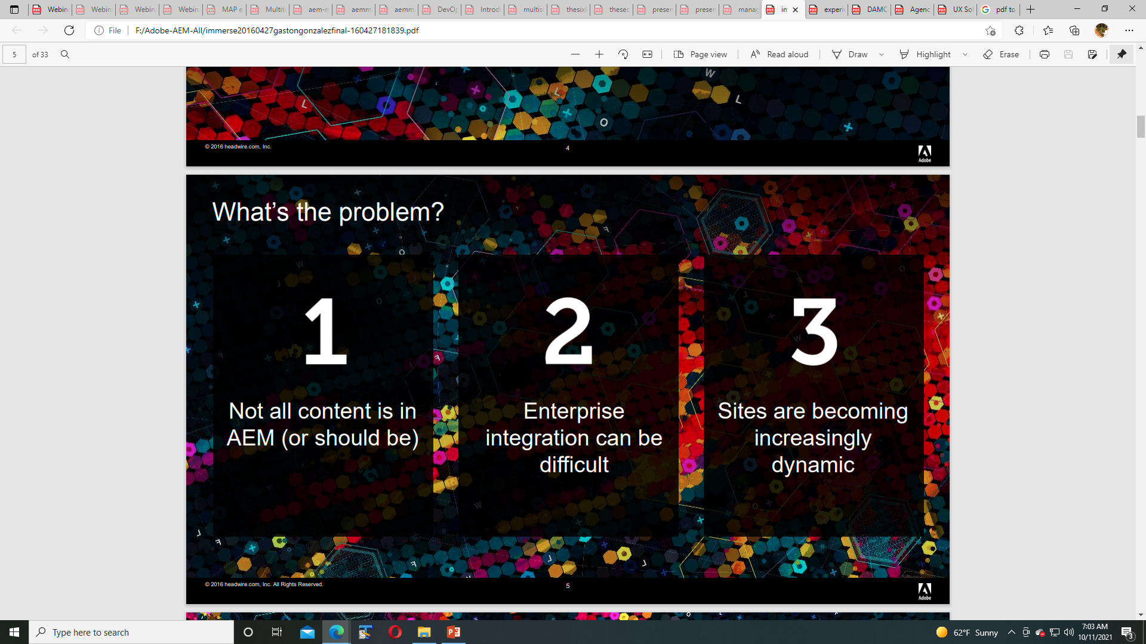

Slide 98
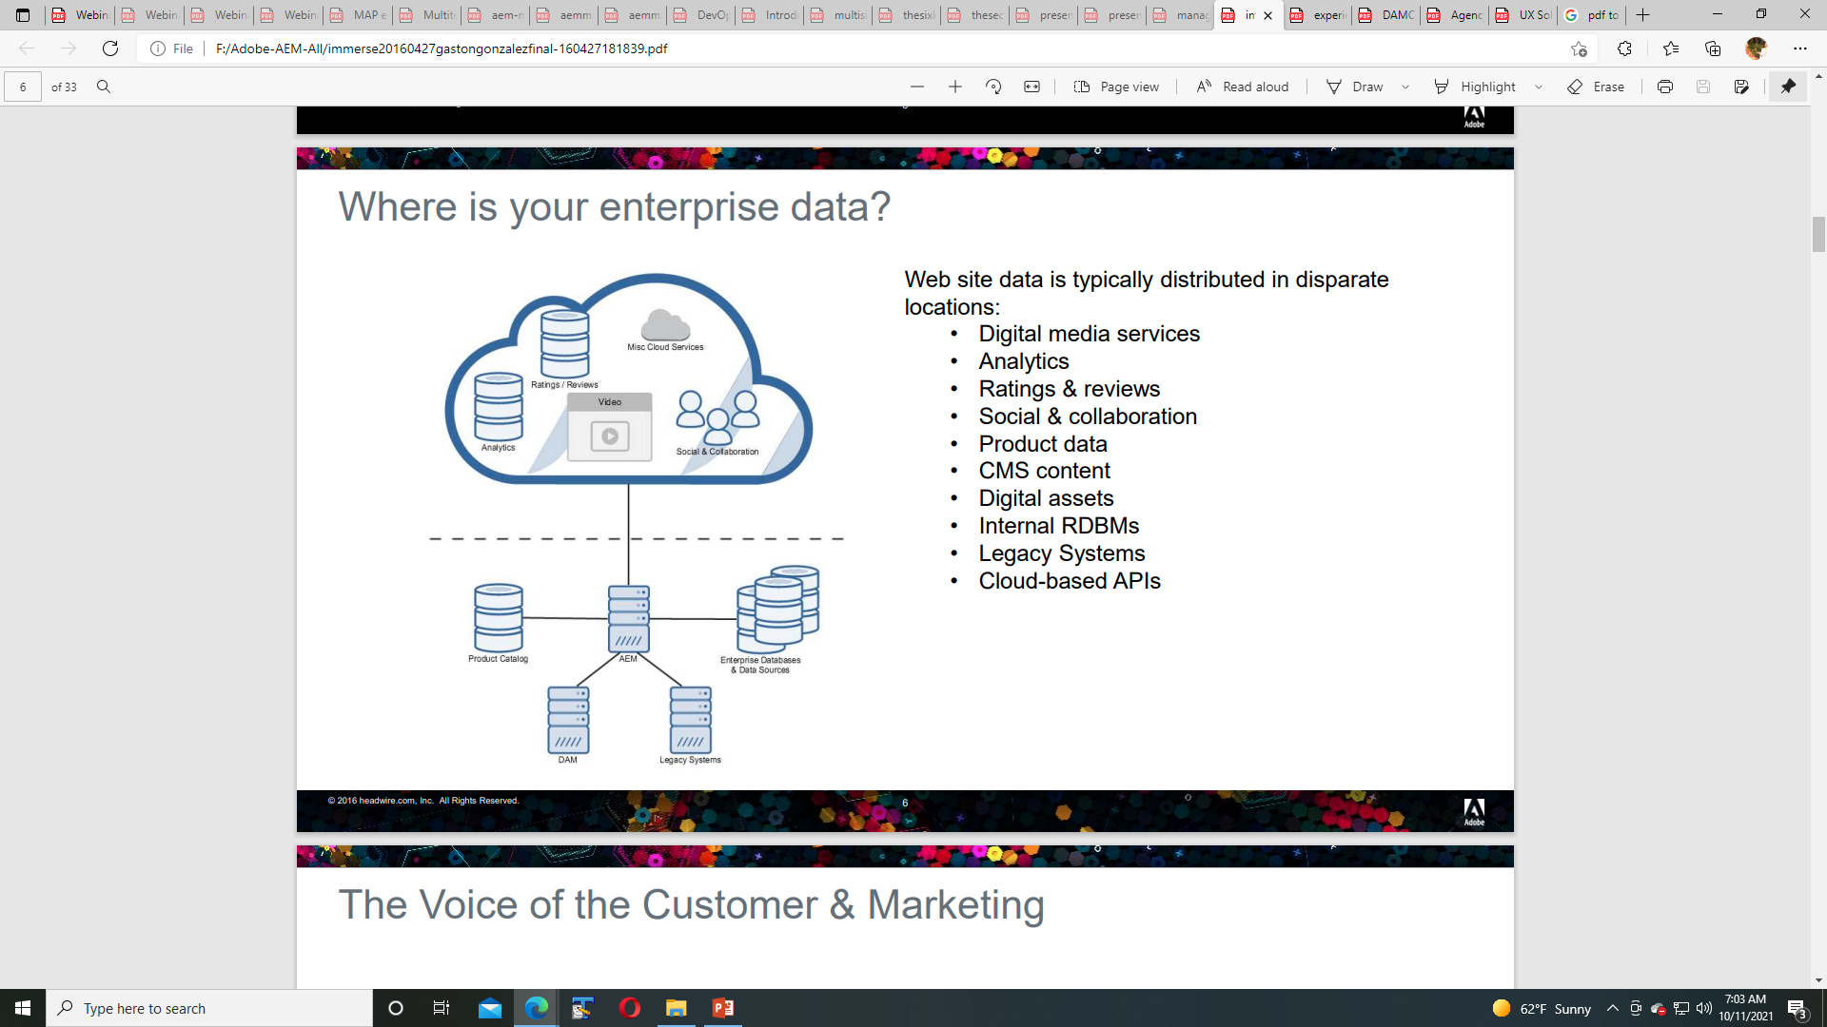

Slide 99
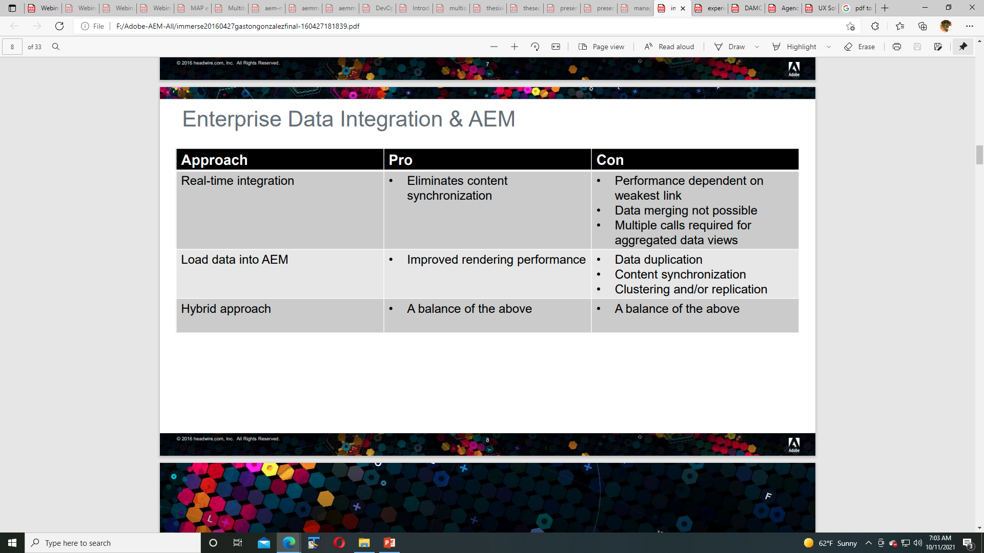

Slide 100
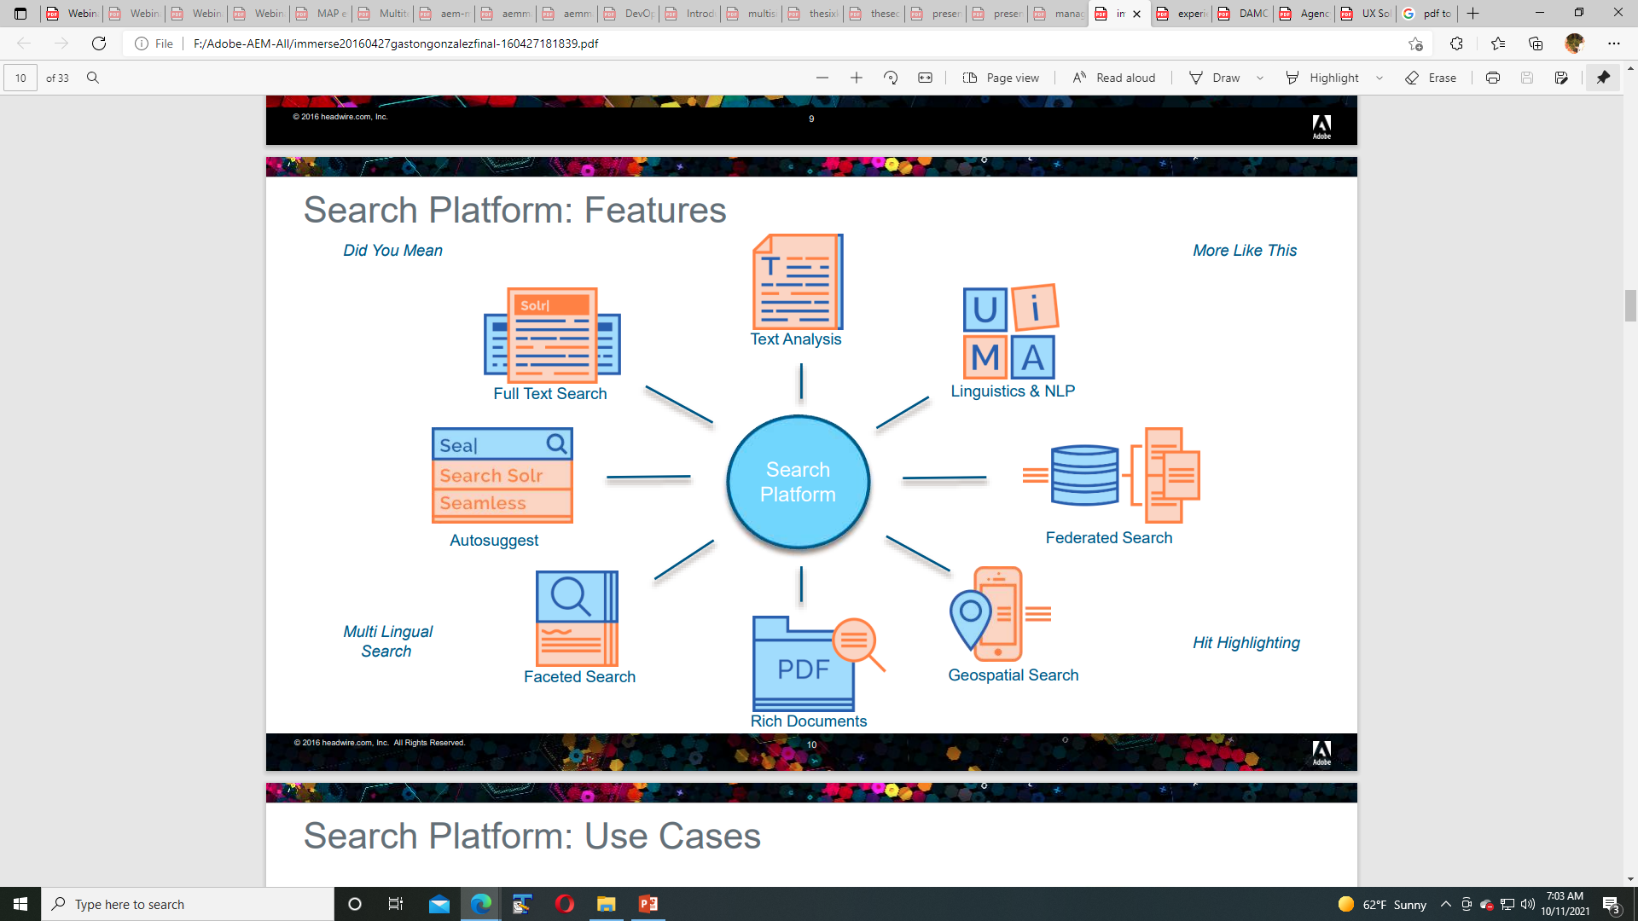

Slide 101


Slide 102


Slide 103


Slide 104


Slide 105


Slide 106


Slide 107


Slide 108


Slide 109


Slide 110


Slide 111


Slide 112


Slide 113


Slide 114
CONTENTS
Introduction 1
AEM Background 1
DevOps Expertise 1 DevOps Automation 2 Our Pragmatic DevOps Services Framework 2
Build Automation 3
Deployment Automation 6
Test Automation
9
Infrastructure Automation 12

Slide 115
DevOps Automation
INTRODUCTION
Just as the Industrial Revolution introduced the manufacturing industry to rolling assembly lines and automated processes, DevOps processes are ingrained with automation techniques that provide rapid feedback, repeatable processes, and consistent creation of business application systems. With the convergence of multiple systems and IT professionals all focusing on the delivery of these applications, these processes quickly become complex and can seem daunting to implement for the first time.
Our experts have grouped these processes into four areas of focus for implementing automation that can each help your organization gain efficiencies and improve your overall IT processes: Build, Deployment, Test, and Infrastructure. With each of these areas, AEM’s experts will guide your organization in the development of optimized IT processes that adopt core enabling disciplines, monitor key performance indicators, and avoid potential red flag areas.
Our Pragmatic DevOps Services Framework
Discover
DevOps Discovery & Readiness Assessment
PHASE 1
Foundation
Design
DevOps Implementation Roadmap Workshop
PHASE 2
Automation
Accelerate Implement Validate
Build Automation
Deployment Automation
Test Automation
Infrastructure Automation
Optimize Improve Evolve
Continuous Delivery Adoption
PHASE 3
Streamline
Site Reliability Engineering
PHASE 4
Transformation
Mature
Autonomous Business Applications

Slide 116




BUILD AUTOMATION
BUILD AUTOMATION
Build Automation is the process of scripting and automating the retrieval of software code from a repository, compiling it into a binary artifact, executing automated functional tests, and publishing it into a shared and centralized repository.
Deﬁne and execute a consistent and repeatable process.
Improve overall release deployment quality.
Amplify feedback and improve team communication.
Accelerate the implementation of desired business features/functionalities.
Models
In this diagram, given the items on the left, implementing Build Automation will result in the items on the right.
Deﬁned Build Manifest
Improved team efﬁciency with higher production and better quality
Trunk-based Code Repository
Faster Software Delivery & Business Feature Implementation
Build
Software Build & Assembly Procedures
Automation
Better Team Communication & Collaboration
A typical automated build process is shown in the diagram below. This will vary slightly based upon team structure and organization focus.
Build Orchestration Engine
Minimal Rework and Fewer Detective Builds
1
2
3
4
5
6
7
8
Develop Code
Commit Code
Compile Code
Inspect Code
Unit Test
Test Functionality
Create Package
Publish Package

Slide 117






Red Flag Areas
BUILD AUTOMATION
Key Metrics
Lack of Source Code Tool Expertise
is a barrier to frequent code commits.
This often leads to complicated integration issues and inhibits overall team visibility
of the code base.
Number of Features / User Stories per Build
indicates the number of changes being implemented and maps to business value being created.
Change Implementation
Lead Time
affects the number of releases per a given period and overall product roadmap planning.
Complicated Source Code Branching leads to duplicate changes and complex merges.
Infrequent Check-ins of Code leads to complex change merges and delayed integrations.
Average Build Time
indicates the average time to perform a build.
Frequency of Builds
indicates the overall output and activity of the project.
Broken Builds
diverts focus of development teams away from new feature creation.
Percentage of Failed Builds
impacts the overall team output due to rework.
Minimal Feedback
negatively affects overall quality due to “lack of eyeballs.”
Key Roles
Excessive Notiﬁcations
result in team members ignoring important alerts.
Developer
Responsible for taking business requirement and implementing in software code
Build Engineer
Responsible for defining the release pipelines and maintaining the build infrastructure
Requirements Analyst
Responsible for defining the user story to include the
definition of acceptance criteria
Bloated Builds
prevent rapid feedback and creates potential bottlenecks.
Infrequent Builds
delay feedback and identification of potential integration issues.

Slide 118
Service Engagements
BUILD AUTOMATION
Why AEM?
AEM's assessment-derived solutions are tailored to your needs. We work with you to define the right offerings required to build a solid foundation based on DevOps principles. The time and scope will vary based on your needs, but representative offerings based on previous client engagements are shown below.
Delivering business applications with conﬁdence
Current work includes powering the collection of millions of data points from hundreds of stakeholders; enabling oversight for $1 billion+ in grants; and managing a global housing system that supports more than
a million end users.
Expert Consulting
Mentoring and Implementation Consulting Services
Work collaboratively with AEM experts to mentor and provide expert consulting for automating your software build and packaging processes.
Accelerators
Continuous Integration Implementation Pilot
In this hands-on guided lab, participants will implement an automated software build process that includes static code analysis.
Build Artifact Repository Implementation Pilot
Participants will expand on the automated build process to learn how to leverage central repositories for package and dependency management.
99%
success rate during production releases
Workshops
Software Assembly Best Practices
Learn best practices for building and packaging software components. Topics include dependency management, build manifests, and source code management.
Code Analysis Strategies & Tools
Learn about static code analysis techniques and common tools to use for improving software quality.
Our DevOps approaches enable a 99% success rate during production release and 99%+ availability of all servers.

Slide 119






DEPLOYMENT AUTOMATION
DEPLOYMENT AUTOMATION
Deployment Automation is the process of provisioning the application artifacts and configurations to the operating environments across the system development lifecycle. It entails a combination of application deployment automation, environment modeling, and workflow orchestration to achieve rapid delivery of application features in a reliable and orderly manner.
Deﬁne and execute a consistent and repeatable process.
Amplify feedback and improve team communication.
Improve overall release deployment quality.
Accelerate the delivery of application features to production.
Models
In this diagram, given the items on the left, implementing Deployment Automation will result in the items on the right.
Trunk-based Code Repository
Reduced Employee Burnout
Version-controlled Application and System Conﬁguration
Faster Software Delivery & Business Feature Implementation
Deployment Automation
Application Deployment Procedures
Better Team Communication & Collaboration
A typical release process is shown in
the diagram below. This will vary slightly based upon team structure and organization focus.
Release Orchestration Engine
Stable & Consistent Application Hosting Environments
1
2
3
4
5
6
7
Retrieve Application Artifacts
Deploy to Test
Validate Test
Promote to Stage
Validate Stage
Promote to Production
Validate Production

Slide 120








Red Flag Areas
DEPLOYMENT AUTOMATION
Key Metrics
Lack of Source Code Tool Expertise
is a barrier to frequent code commits.
This often leads to complicated integration issues and inhibits overall team visibility
of the code base.
Time to Fulﬁll Environment Provisioning Request
redirects resources from application and business feature development and impacts time required for each release.
Average Deployment Time
impacts the available time for deployments.
Embedded System and/or Application Conﬁgurations
often require complicated code changes to account for specific environment configurations and may introduce complex code merges for different target environments.
Number of Features/ User Stories per Build
indicates the number of changes being implemented and maps to business value being created.
Percentage of Failed Deployments
impacts the overall team output due to rework.
Infrequent Check-ins of Conﬁgurations
lead to misconfigured environments and tribal knowledge of environment requirements.
Frequency of Deployments
indicates the overall output and activity of the project.
Inconsistent Environments
increase deployment tasks and introduce instability into environments due to variations in topology and configurations.
Key Roles
Excessive Notiﬁcations
result in team members ignoring important alerts.
System Administrator
Responsible for preparing and modeling the target environments and deploying the application into each of them
Build Engineer
Responsible for defining the release requirements and supporting the application deployment
Release Manager
Responsible for defining and communicating the application release plans and reporting on the progress of the deployments
Long-running Deployments prevent rapid feedback and create potential bottlenecks.
Infrequent Deployments
lead to the outdated system provisioning procedures and environment definitions, which ultimately impact the overall system stability.
7

Slide 121
Service Engagements
DEPLOYMENT AUTOMATION
Why AEM?
AEM's assessment-derived solutions are tailored to your needs. We work with you to define the right offerings required to build a solid foundation based on DevOps principles. The time and scope will vary based on your needs, but representative offerings based on previous client engagements are shown below.
Delivering faster...
By implementing application build & release pipelines into the Department of Education's non-production environments, AEM streamlined the process for 11 applications and reduced required time by one man-week per month.
Expert Consulting
Mentoring and Implementation Consulting Services
Work collaboratively with AEM experts to mentor and provide expert consulting for automating your application release and deployment process.
With less...
After AEM helped a major publishing company implement a complete release management pipeline, they were able to manage the release of over 100 microservices applications with a release management team of only three people.
Accelerators
Release Deployment Pipeline Implementation Pilot
In this hands-on guided lab, participants define and automate a process for deploying applications into Dev, Test, and Production environments.
Application Container Implementation Pilot
Leverage application containers to deploy and manage their application release.
Workshops
Release Automation Best Practices
Learn best practices for automating the deployment of applications into environments across the software lifecycle.
Container Implementation Strategies
Learn the basics of application containers and their importance in the release and deployment process.
8

Slide 122






TEST AUTOMATION
TEST AUTOMATION
Test Automation is a practice where application tests are run automatically and continuously throughout the development process. Test-driven development and the use of unit tests are used to create and maintain acceptance tests that are reproducible and executed with each build.
Deﬁne and execute a consistent and repeatable process.
Improve overall release deployment quality.
Amplify feedback and improve team communication.
Accelerate the delivery of application features to production.
Models
Applications require several techniques and levels of testing to meet quality and user expectations. A typical project will implement a strategy similar to that of the Agile Testing Quadrants model shown here.
Business Facing
Automated
Functional Acceptance Tests
Manual
Showcase Usability Testing
Exploratory Testing
Requirement Veriﬁcation
Function Validation
Automated
Unit Tests Integration Tests System Tests
Manual / Automated
Non-functional acceptance
Capacity • Security • Compliance
The stages of Test Automation are shown in the diagram below. These will vary slightly based upon team structure and organization focus.
Technology Facing
1
1
2
3
8
Commit Stage
Unit Test
Code Analysis
Retrieve Application Artifacts
Automated Acceptance Testing
Capacity
External Dependencies
Automated Performance Testing
Release to Production
9

Slide 123







Red Flag Areas
TEST AUTOMATION
Key Metrics
Lack of Code Coverage Statistics indicates limited testing being done during development.
Test Code Coverage
identifies the percentage of code in which functionality has been verified.
Defects Reported Post Release
indicates that requirements may not have a common understanding and/or automated testing is incomplete.
Lack of Quality Test Data
indicates poor test data management, which will produce unexpected application results in production.
Long-running Test Suite
conflicts with the need for fast builds and often results in tests being skipped during builds.
Average Test Execution Suite Time
impacts the available time for builds.
Excessive Notiﬁcations
result in team members ignoring important alerts, particularly for test results that produce false positives for defects.
Key Roles
System Administrator
Responsible for preparing and modeling the test environments and deploying the application into each of them
Test Engineer
Responsible for defining the release pipelines and maintaining the build infrastructure
Developer
Responsible for the application development and defect resolution
Release Manager
Responsible for defining and communicating the application release plans and reporting on the progress of the deployments
10

Slide 124
Service Engagements
TEST AUTOMATION
Why AEM?
AEM's assessment-derived solutions are tailored to your needs. We work with you to define the right offerings required to build a solid foundation based on DevOps principles. The time and scope will vary based on your needs, but representative offerings based on previous client engagements are shown below.
Building quality in…
For the Department of Education’s GENERATE project, AEM executes over 1,500 unit and integration tests with each TeamCity build to enhance the quality of each release.
Expert Consulting
Mentoring and Implementation Consulting Services
Work collaboratively with AEM experts to mentor and provide expert consulting for automating acceptance testing and security policies.
To provide consistent functionality...
AEM worked with ITHAKA to build a Selenium-based test suite for their JSTOR application. Using this automated test suite, they were able to validate and maintain
functionality across multiple browser platforms with each application release.
Accelerators
Test-Driven Development Implementation Pilot
Work through a hands-on guided exercise to implement unit tests using the practice of TDD.
Security and Compliance Automation Pilot
Integrate common security hardening implementation guidelines and build a foundation for deploying and reporting current status.
Workshops
TDD, BDD, and Unit Test Strategies
Learn the basics of Unit, Behavior, and Test-Driven Development approaches and how they are used to improve software quality.
Automating Security & Compliance
Learn tools and practices for implementing and monitoring security and compliance policies.
11

Slide 125

INFRASTRUCTURE AUTOMATION
INFRASTRUCTURE AUTOMATION
Infrastructure Automation is the process of creating and tearing down server and application infrastructure to support the development, testing, and production environments.
Deﬁne and execute a consistent and repeatable process.
Amplify feedback and improve team communication.
Improve overall release deployment quality.
Accelerate the delivery of application features to production.
Models
In the diagram below, given the items on the left, implementing Infrastructure Automation will result in the items on the right.
Trunk-based Code Repository
Reduced Time to Fulﬁll Infrastructure Needs
Version-controlled Application and System Conﬁguration
Reduced Capital Expenses Costs due to On-Demand Provisioning Model
Infrastructure Automation
Deﬁned Infrastructure System Topology
Improved & Accurate Documentation of Hosting Environments
Hosting Provider APIs and Services
Stable & Consistent Application Hosting Environments
12

Slide 126





Red Flag Areas
INFRASTRUCTURE AUTOMATION
Key Metrics
Embedded System and/or Application Conﬁgurations
lead to complicated code changes to handle environment changes and target releases.
Time to Fulﬁll Environment Provisioning Request
redirects resources from application and business feature development and impacts time required for each release.
Frequency of Deployments
indicates the overall output and activity of the project.
Infrequent Check-ins of Conﬁgurations lead to misconfigured environments and tribal knowledge of environment requirements.
Inconsistent Environments
increase deployment tasks and introduce instability into environments due to variations in topology and configurations.
Average Deployment Time
impacts the available time for deployments.
Percentage of Available Capacity
indicates whether an environment is sized correctly and identifies potential stability issues that will occur when available resources are exhausted.
Excessive Notiﬁcations
result in team members ignoring important alerts.
Long Provisioning Request Fulﬁllments
prevent rapid changeover and
on-demand creation and scaling of supporting infrastructure elements.
Key Roles
System Administrator
Responsible for preparing and modeling the target environments and deploying the application into each of them
Build Engineer
Responsible for defining the release requirements and supporting the application deployment
Release Manager
Responsible for defining and communicating the application release plans and reporting on the progress of the deployments
Infrequent Deployments
system provisioning runbooks could atrophy over time and without regular exercising of procedures, environment definitions, which could become outdated.
13

Slide 127
Service Engagements
INFRASTRUCTURE AUTOMATION
Why AEM?
AEM's assessment-derived solutions are tailored to your needs. We work with you to define the right offerings required to build a solid foundation based on DevOps principles. The time and scope will vary based on your needs, but representative offerings based on previous client engagements are shown below.
Fortune 500 Financial Services Company
Challenge
Modernize an underfunded IT infrastructure to improve business agility while adhering to industry regulations.
Expert Consulting
Mentoring and Implementation Consulting Services
Work collaboratively with AEM experts to mentor and provide expert consulting for implementing your infrastructure automation solutions.
Solution
Automate Day 1 and Day 2 operations to accelerate the ability to respond to business needs.
Accelerators
Change & Patch/Release Management Pilot
Learn how to promote changes throughout the software lifecycle in this hands-on lab.
Infrastructure Automation Pilot
Learn how to use Infrastructure-as-Code techniques to create software environments with a public
cloud environment.
Results
98% reduction in time to fulfill IT provisioning requests
Created a single platform to provide Infrastructure, Platform, and Database-as-a-Service capabilities
Workshops
Infrastructure as Code Strategies
Learn key concepts and practices for defining IT infrastructure in formats that can be consistently deployed.
Installation & Provisioning Tools
Learn about some of the key applications that are used to deploy today’s modern infrastructures.
Conﬁguration Management Strategies
Learn key concepts for externalizing and managing environment configurations.
14

Slide 128
What maintenance do we need?
Tar Storage
Offline Compaction / Online Compaction
External Blob Storage
File and S3 Data Store Garbage Collection
AEM Maintenance
Version Purge
Audit Log Maintenance
Workflow Purge
Mongo Storage
Revision Garbage Collection (online)
Blob Garbage Collection

Slide 129
Tar Compaction (AKA Revision Cleanup) - Introduction
Background Info
Oak Segment Store only appends data, and updates references to the latest revision
Tar compaction is needed to delete old revisions.
Two types: Online and Offline
How it works
Compaction reclaims disk space used by old revisions
Broken up into 3 phases
Calculate if it needs to run
Rewrite the latest revision to new tar files – “compaction” step
Delete the old tar files

Slide 130
Tar Storage Offline Compaction
How to run
Download oak-run jar: http://repo1.maven.org/maven2/org/apache/jackrabbit/oak-run/
AEM6.0 – 1.0.x version of oak-run
AEM6.1 – Oak 1.2.x
AEM6.2 – Oak 1.4.x
AEM6.3 – Oak 1.6.x
Take a backup of the repository
Run the offline compaction command (next slide)

Slide 131
Tar Storage Offline Compaction Command
Linux
sudo -u crx nohup /usr/java/latest/bin/java -Dtar.memoryMapped=true -Doak.compaction.eagerFlush=true -server -Xmx30g
-Dcompaction-progress-log=5000000 -Dcompress-interval=150000000 -jar oak-run-*.jar compact /path/to/segmentstore >> oak-tar-compact-a0.log 2>>oak-tar-error-a0.log
Windows (omit the -Dtar.memoryMapped=true parameter)
java -Xmx30g -Doak.compaction.eagerFlush=true -server -Dcompaction-progress-log=5000000 -Dcompress- interval=150000000 -jar oak-run-*.jar compact D:\path\to\segmentstore >> tarcompaction.log
-Dtar.memoryMapped=true – only on Linux and UNIX
-Doak.compaction.eagerFlush=true – Prevents memory errors

Slide 132

Offline Compaction - Sample log output
Apache Jackrabbit Oak 1.4.13
Compacting crx-quickstart/repository/segmentstore before
Fri Oct 14 12:19:30 EDT 2016, data00000a.tar
Wed May 17 10:37:46 EDT 2017, data00001b.tar
Fri Oct 14 12:20:22 EDT 2016, data00002a.tar
............
Wed May 17 10:37:45 EDT 2017, data00011b.tar
Sun Jul 16 16:12:39 EDT 2017, journal.log
Fri Oct 14 12:19:24 EDT 2016, repo.lock
size 7.7 GB (7712731491 bytes)
-> compacting
-> cleaning up
-> removed old file data00074a.tar
-> removed old file data00073a.tar
-> removed old file data00072a.tar
….…
-> removed old file data00018b.tar
-> writing new journal.log: a838c3e9-613f-4095-abba- 939c437882e7:59384 root
after
Fri Oct 14 12:19:30 EDT 2016, data00000a.tar
Wed May 17 10:37:46 EDT 2017, data00001b.tar
.............
Wed May 17 10:37:46 EDT 2017, data00003b.tar
Wed May 17 10:37:45 EDT 2017, data00004b.tar
Mon Jul 17 11:11:28 EDT 2017, journal.log
Fri Oct 14 12:19:24 EDT 2016, repo.lock
size 6.4 GB (6385295920 bytes)
removed files [data00057a.tar, data00065a.tar, data00020b.tar, data00018b.tar, data00050b.tar, data00073a.tar, data00058a.tar, data00069a.tar, data00060a.tar, data00063a.tar, data00074a.tar, data00066a.tar, data00055a.tar, data00062a.tar, data00036b.tar, data00070a.tar, data00068a.tar, data00072a.tar, data00067a.tar, data00049b.tar, data00061a.tar, data00056a.tar, data00064a.tar, data00059a.tar]
added files [data00050c.tar, data00065b.tar, data00073b.tar, data00056b.tar, data00072b.tar, data00066b.tar, data00069b.tar, data00063b.tar, data00018c.tar, data00058b.tar, data00060b.tar, data00074b.tar, data00020c.tar, data00059b.tar, data00070b.tar, data00062b.tar, data00061b.tar, data00036c.tar, data00075a.tar, data00057b.tar, data00049c.tar]
Compaction succeeded in 21.76 s (21s).

Slide 133
Debugging Offline Compaction
1. Create a file logback-compaction.xml (in the same folder as the oak-run jar)
<configuration>
<appender name="STDERR" class="ch.qos.logback.core.ConsoleAppender">
<target>System.err</target>
<encoder>
<pattern>%d{HH:mm:ss.SSS} [%thread] %-5level %logger{36} - %msg%n</pattern>
</encoder>
</appender>
<logger name="org.apache.jackrabbit.oak.plugins.segment.Compactor" level="INFO"/>
<root level="warn">
<appender-ref ref="STDERR" />
</root>
</configuration>
2. Add to the compact command:
-Dlogback.configurationFile=logback-compaction.xml

Slide 134

Tar Storage Offline Compaction
How often do we run offline compaction?
At least every 2 weeks on a high write activity system
Otherwise, monthly
What happens if we don’t run it?
Oak’s performance will degrade
Disk usage will max out

Slide 135
Avoiding Pitfalls – Common Issues
Disable online compaction on AEM 6.2 and lower
Broken async indexing affects compaction
Check that last indexed time is recent to make sure indexing is working
JMX > IndexStats – async > LastIndexedTime
JMX > IndexStats – fulltext-async > LastIndexedTime
Make sure you have at least the size of segmentstore in free space

Slide 136

Tar Storage Online Compaction (AEM 6.3 and higher)
How to run
Schedule task via Touch UI
Done!
How it works
Runs automatically on schedule
If not completed in window (default 2am -5am), then it will pause
Next time it continues from where it left off
Full guide on online compaction:
https://docs.adobe.com/docs/en/aem/6-3/deploy/platform/revision-cleanup.html

Slide 137
Online Compaction – Sample Log Output
Scenario 1: Not enough changes in the repository to warrant a compaction:
org.apache.sling.event.impl.jobs.queues.JobQueueImpl.Maintenance Queue Starting job queue Maintenance Queue org.apache.jackrabbit.oak.segment.file.FileStore TarMK GC #1: started
org.apache.jackrabbit.oak.segment.file.FileStore TarMK GC #1: setting up a listener to cancel compaction if available memory on pool 'PS Old Gen' drops below 15%, 107.4 MB (107426611 bytes).
org.apache.jackrabbit.oak.segment.file.FileStore TarMK GC #1: available memory level 550.5 MB (550532136 bytes) is good, expecting at least 107.4 MB (107426611 bytes)
org.apache.jackrabbit.oak.segment.file.FileStore TarMK GC #1: estimation started org.apache.jackrabbit.oak.segment.file.FileStore TarMK GC #1: estimation completed in 3.152 ms (3 ms). Segmentstore size has
increased since the last garbage collection from 227.7 MB (227665920 bytes) to 541.0 MB (541002240 bytes), an increase of 313.3 MB (313336320 bytes) or 137%. This is less than sizeDeltaEstimation=1.1 GB (1073741824 bytes), so skipping garbage collection

Slide 138
Online Compaction – Sample Log Output
Scenario 2: Repository increased in size past threshold. Compaction is done
TarMK GC #2: started TarMK GC #2: …..
TarMK GC #2: estimation started
TarMK GC #2: estimation completed in 6.373 ms (6 ms). Segmentstore size has increased since the last garbage collection from 417.9 MB (417905664 bytes) to 844.2 MB (844169728 bytes), an increase of 426.3 MB (426264064 bytes) or 102%. This is greater than sizeDeltaEstimation=100.0 MB (100000000 bytes), so running garbage collection
TarMK GC #2: compaction started, …
TarMK GC #2: estimated number of nodes to compact is 442708, based on 442307 nodes compacted to 417905664 bytes on disk in previous compaction and current size of 418285056 bytes on disk.
TarMK GC #2: compaction cycle 0 completed in 52.96 s (52956 ms). Compacted ff940e56-3a69-4721-ab80-74210b7beae9.00000034 to 8ddf7c10- 1af6-41f8-aa99-6b750e09e00b.00000533
TarMK GC #2: ……
TarMK GC #2: compaction succeeded in 53.07 s (53072 ms), after 1 cycles TarMK GC #2: cleanup started.
TarMK GC #2: current repository size is 530.8 MB (530752512 bytes)
….
cleanup marking files for deletion: …….
cleanup completed in 1.584 s (1584 ms). Post cleanup size is 223.9 MB (223906816 bytes) and space reclaimed 306.8 MB (306845696 bytes). Removed files: ……
TarMK closed: …….

Slide 139
Tar Compaction
Offline compaction frees more space
Offline - keeps the latest revision only
Online - keeps revisions since two compactions prior
Compacting publish instances
Run during low traffic hours
Stagger across publish instances
Duration of compaction depends on
Repository size
System load
Activity patterns (reads vs. writes)
Hardware specifications

Slide 140
Offline vs. Online Compaction
Offline Compaction
AEM 6.0 – 6.3
Downtime required Cleans all old revisions Has to run to completion Runs faster
Bi-weekly
Online Compaction
AEM 6.3 and future versions
Keeps revisions since two compactions prior Only runs during maintenance window Speed is restricted by system activity
No downtime
Daily

Slide 141
Blob GC / Datastore Garbage Collection
How to run it
Default schedule: Weekly on Saturdays at 1AM
Start on demand: JMX > RepositoryManagement > startDataStoreGC
Runs to completion
Log messages:
Starting Blob garbage collection with markOnly [false] Collected (1024) blob references
….
Deleted blobs [……….]
….
Blob garbage collection completed in 4.569 s (4568 ms). Number of blobs deleted [6341] with max modification time of [2017-07-16 22:03:55.295]

Slide 142
Workflow Purge
How often?
Weekly
Default: Saturdays at 1 am
How it works
Deletes old workflow history nodes under /etc/workflow/instances

Slide 143

Workflow Purge
How to run it
Configure
Workflow Models to purge
Age of instances to purge
Multiple configurations allowed
Can be started manually via JMX console:
JMX > Workflow (maintenance) > PurgeCompleted()
Full guide on Workflow Purge:
https://docs.adobe.com/docs/en/aem/6- 3/administer/operations/workflows/administering.html#Regular%20Purging%20of%20Workflow
%20Instances

Slide 144
Workflow Purge – Log messages
*INFO* [Workflow Purge: 'DAM Workflows'] com.adobe.granite.workflow.core.mbean.WorkflowOperationsImpl Begin workflow purge with the following parameters:
dry run: false days old: 0
states: {COMPLETED, ABORTED}
models: {/etc/workflow/models/dam/update_asset/jcr:content/model ,/etc/workflow/models/dam-xmp-writeback/jcr:content/model} purge save threshold: {20} purge query count: {1000}
*INFO* [Workflow Purge: 'DAM Workflows'] com.adobe.granite.workflow.core.mbean.WorkflowOperationsImpl Cleaned up 1006 instances
*INFO* [Workflow Purge: 'DAM Workflows'] com.adobe.granite.workflow.core.mbean.WorkflowOperationsImpl Finished running Workflow Purge. Purged: 1006 items. Elapsed time (seconds): 0
*INFO* [Workflow Purge: 'DAM Workflows'] com.adobe.granite.workflow.core.mbean.PurgeScheduler Finished running Workflow Purge Configuration: DAM Workflows. Purged: 1006 items. Elapsed time (seconds): 0

Slide 145

Demo – Online/Offline Compaction - Workflow Purge

Slide 146
Version Purge
Background Info
Versions are stored under /jcr:system/jcr:versionStorage
jcr:content node references the version history by jcr:uuid
How it works
Retrieves the versions
Deletes old ones based on configurable rules

Slide 147
Version Purge
What actions create versions?
(De-)Activating / (Un-)Publishing pages or assets
Uploading or replacing assets
Creating a version of a page or asset manually via the UI

Slide 148

Version Purge
Version history node
Version nodes

Slide 149
Version Purge
How often do we run “Version Purge”?
Monthly
Runs until completion

Slide 150

Version Purge
How to run it - 3 ways
Scheduled Maintenance task
Weekly Maintenance Dashboard
OSGI Config: "Day CQ WCM Version Purge Task"

Slide 151

Version Purge

Slide 152

Version Purge
Auto-purge (on version creation)
OSGI Config: “Day CQ WCM Version Manager”
Purge Versions Tool
/etc/versioning/purge.html

Slide 153

Version Purge
Avoid pitfalls
Install the latest Cumulative Fix Pack (CFP)
Avoid running during business hours
Disable versioning on
Replication agents
WebDAV / Desktop App upload
Run before Blob GC or DataStore GC
See this article for details: https://helpx.adobe.com/experience- manager/kb/aem-version-purge-affects- performance.html

Slide 154

Audit Log Purge
Background Info
Audit logs are stored under /var/audit
How it works
Traverse audit logs
Deletes old logs based on configurable rules

Slide 155
Audit Log Purge
How often do we run “Audit Log Maintenance”?
Monthly
Runs until completion
Activities logged
Uploading assets
Modifying asset metadata
Creating, modifying and deleting pages
Publishing and Un-publishing content

Slide 156

Audit Log Purge
How to run it
Weekly Maintenance Dashboard
OSGI Config: “Audit Log Purge Scheduler”

Slide 157
Audit Log Purge
Avoid pitfalls
Schedule on a different day than version purge and workflow purge
Apply the latest CFP
Monitor logs for ERROR log message:
”Exception while purging versions”

Slide 158

MongoDB Revision Garbage Collection
Background info
Similar to TarMK, every write to MongoMK adds a new revision (similar to git or svn)
MongoDB “nodes” collection
Each document is either a node or “split” (older) revisions of a node
MongoDB “settings” collection
Stores “checkpoints” to point to revisions
Async indexing uses “checkpoints”

Slide 159
MongoDB Revision Garbage Collection
How it works
Skip Revision GC if any checkpoint is older than max revision age (default 24h)
Starting log message
VersionGarbageCollector Starting revision garbage collection. Revisions older than [2017-08-16 02:00:01.299] would be removed
Query for nodes marked for deletion
Delete documents
Query for “split” revisions
Delete documents
Completion Message
VersionGarbageCollector Version garbage collected in 36.89 min. VersionGCStats{ignoredGCDueToCheckPoint=false, deletedDocGCCount=499573, splitDocGCCount=687, intermediateSplitDocGCCount=62, timeToCollectDeletedDocs=13.63 min, timeTakenToDeleteDocs=23.16 min}

Slide 160
MongoDB Revision Garbage Collection
How often?
At least daily
Runs until completion
Activities that generate revisions
Anytime JCR Session.save() is called
Index updates

Slide 161

MongoDB Revision Garbage Collection
How to run it
Scheduled by default
Daily maintenance task

Slide 162
MongoDB Revision Garbage Collection
Avoid pitfalls
Run frequently
Decrease the maximum revision age to clean up more revisions
Set versionGCMaxAgeInSecs (DocumentNodeStoreService)
If indexing is stuck, it will break Revision GC

Slide 163
MongoDB Blob GC
Background Info
Default Oak/Mongo storage for binary files – when a DataStore isn’t configured
Not recommended – DataStores performs better
How it works
Collects references to blobs from nodes collection
Performs a mark and sweep in blobs collection

Slide 164
MongoDB Blob GC
How often?
Weekly
Activities that generate blobs
Uploading or saving binary files
Replications
Package uploads and installation

Slide 165
Digital Foundation Sales Play

Slide 166


Slide 167


Slide 168





























Brands Want The Ability to Quickly Create and Deliver Personalized Experiences
Challenges Business Impact
Authors don’t have tools to create experiences without custom development
Marketers don’t have the ability to quickly create and publish content without support from IT
Increase in costs, decrease in efficiency
Given the high cost to manage multiple systems and lack of scalable components and templates
Experiences are generic and inconsistent Inefficient tools and lack of resources to dedicate towards personalization efforts
Loss in Conversion & Revenue
Personalization is table stakes for every customer. All digital experiences must be delivered in context everywhere.
Incomplete understanding of customer segments and behaviors
Little insight into different audiences and how customers engage and react to content
Lack of content velocity to iterate and keep up with demand
Siloed content systems and inability to automate repetitive tasks related to content and asset manipulation across all channels
Loss of Revenue
Poorly tailored experiences due to ineffective measurement and learnings across the customer lifecycle
Slow Time to Market
Slow time to market with new experiences and difficulty keeping up with demand

Slide 169





Digital Foundation Create, Manage, & go to Market Fast
Digital Foundation provides a modern, cloud native solution that enables you to create, manage, and get to market fast with personalized experiences
Scale
Channel agnostic content and layout fragments
Headless content delivery via APIs
Optimize
Intuitive drag and drop analytics/visualization
Detection of statistically significant anomalies
Usage and lifecycle metrics
Personalize
Rules based personalization
Advanced targeting
Visual experience composer
Create
WYSIWYG authoring capabilities for marketing
Production-ready components and styling
DIGITAL EXPERIENCE CREATION
With a digital foundation, customers can create, personalize, optimize, and scale their experiences in under 30 days

Slide 170










Qualification Criteria
Current CMS: Sitecore/Drupal/WP customers
Use Case: Primarily web, customer facing .com site
Key verticals: Software, B2B, Manufacturing, FSI, Healthcare, Retail, Professional Services
Qualifying criteria:
Small marketing and IT teams (<20)
In process of re-platforming/upgrading current CMS
Looking to consolidate on a single, future-proof platform
Aspirations to do personalization

Slide 171








Digital Foundation Capabilities
Low to no code tools to create new experiences
AI/ML driven personalization
Measurement and insights to optimize customer engagement
Channel agnostic tools to scale content creation and reuse
Marketer and developer friendly tools to accelerate time to value
Accelerate personalization efforts through AI/ML automation
Ability to build custom segments based on your key audiences
Create, manage, and deliver content across any channel, device, or app
ALWAYS AVAILABLE, SCALABLE, AND CURRENT
© 2020 Adobe. All Rights Reserved. Adobe Confidential.
©2020 Adobe. All Rights Reserved. Adobe Confidential.

Slide 172

Digital Foundation Package
Digital Foundation Package
AEM Sites
with analytics and personalization foundation packs
Analytics
foundation pack
Equivalent to Adobe Analytics Foundation
Limit on usage: 10M SC/mo
Who Qualifies
All AEM Sites customers on Managed Services or Cloud Service (net new / migrate / upgrade)
who do not own AA or AT, based on sizing
Capabilities included
A/B Testing
Multivariate testing
Fluid personalization
Auto-allocate
Segment builder
Anomaly detection
SPA Analytics
Rules based personalization
Advanced audience capabilities
Customer journey
optimization
Analysis workspace
Mobile analytics
Usage and lifecycle metrics
Activity maps
Content insights
Personalization foundation pack
Equivalent to Adobe Target Standard
Limit on usage: 10M PV/yr
©2020 Adobe. All Rights Reserved. Adobe Confidential.

Slide 173
Introduction to Digital Foundation Blueprint

Slide 174









Lead with a best practice, Adobe defined approach to AEM implementations
Future proof
Ensures projects are aligned to the Adobe standard and are compatible with future changes to product
Repeatability & scalability
Increases the volume and efficiency of projects by adopting a repeatable approach to implementations
Faster time to value
Earns customer confidence by delivering value early on as well as in phase 2

Slide 175


The Digital Foundation will accelerate and streamline your AEM implementations
Recommended project flow
Defined, best practice approach
that aligns design and build
Value delivered with quick go- live
Custom build for added value in Phase 2
Value delivered by custom build
Adobe defined approach: The Digital Foundation Blueprint
Partner defined frameworks for Phase 2

Slide 176

The Digital Foundation will accelerate and streamline your AEM implementations
The Digital Foundation Blueprint is a
Defined, best practice approach that aligns design and build
Value delivered with quick go- live
holistic approach that starts with solution design, builds out the experience in AEM, and optimizes that experience based on the customer use case.
Adobe defined approach The Digital Foundation Blueprint
Solution Design
Foundation Build
Optimization & Support
UX SOLUTION DESIGN
SSO SUPPORT
CONTENT ANALYSIS
GO-LIVE (CUTOVER TESTING)
SIMPLE PERSONALIZATION
ASSESSMENT & ROADMAP
CONTENT ARCHITECTURE
GLOBAL CSS, FIRST X COMPONENT/STYLE SYSTEM CSS
PERSONALIZATION USE CASE
CONTENT/TAG DEFINITION
CONTENT BUILDOUT
CONTENT VELOCITY OPTIMIZATION
AEM STYLE DEFINITION
SSO CONFIGURATION
AEM HARDENING
COMPONENT STYLING

Slide 177



What is in Digital Foundation Blueprint?
The Digital Foundation Blueprint includes a set of open source tools, guidance and documentation, and automation tooling designed to standardize and streamline the way AEM, AA, and AT are implemented
Open Source Tools
Archetypes, core components, and a data layer on GitHub
Best Practices Documentation
Guides and runbooks for execution, reporting, UX design, and optimization
Automation
Automated integration points and dynamic tag management

Slide 178








Examples of Blueprint success
90% Core Components
Full site live in under 90 days
Target and Analytics integrated
80% Core Components
Full site live in under 90 days
Analytics integrated
6 weeks of implementation for replatform

Slide 179
Blueprint Deep Dive

Slide 180


Blueprint Deep Dive – Timeline View
Accelerated TTV

Slide 181

Getting Started Tip #1 Project Setup
Use the Maven Archetype 25+ to create your project
Creates your initial Configuration
Creates the base page template
Experience Fragment place holder for header/footer
Sets up a simple dispatcher configuration
Sets up Core Components for almost immediate use

Slide 182

Getting Started Tip #2 - Keep current on Core Component Library
Anatomy of a Component:
• Dialog box
• Markup
• Content Logic
• Sling Models
• Edit/Preview behavior
• Documenting & Writing test scripts
When reviewing UX/Wireframes, examine the authorable elements & ask “is there a core component with matching elements”.
Is there a Core Component that comes close in terms of authorable elements?

Slide 183


Getting Started Tip #3 Develop Front End flow that leverages Style Systems
Use UI.Frontend module (a webpack project) to build AEM clientside libraries in a FrontEnd dev friendly way
Or Create your own process. This setup process will be repeatable for every new project.
Simple example → FED owns a folder containing sass based CSS work. Java Dev uses an editor script to compile sass into a css file & places in an existing node structure with the appropriate AEM Clientlib meta
Get your FED, Content Authors aligned on the best User Experience for creating content.
Incorporate the BEM notations into the FED process to allow for multi- faceted variations of Core Components.

Slide 184
Digital Foundation Blueprint – High Level tasks
Category | Section | Task | Owner
Content Architecture | Content Types | Page Types | Content Author
 |  | Experience Fragments | Content Author
 | Components | Templates | Content Author/FED
 |  | Page Authoring | Content Author
Front End Design | Style System | Component/Style Reference | FED/Content Author
 |  | Editable Templates | Content Author/FED
Content Authoring | Taxonomy | Content Taxonomy | Content Author
 |  | Experience Fragments | Content Author
Personalization & Analytics | Launch/AA | Automation | Architect

Slide 185






Content Architecture – Content Types
The Maven Archetype based project setup will generate a blank template for your Content Authors. Content Admins can create as many page templates as needed.
Content Admins should review UX designs & using the UI, create unique page templates. Typically, you will need home + additional page templates based on your needs.
For Each page template, map appropriate header/footer XF as well as required components (with their configurations).

Slide 186



Content Architecture – Component Mapping

Slide 187


Front End Design to Content Authoring
The style variations (rendering or toggling elements) is the responsibility of the Front End Dev.
The registration of a style is the responsibility of the Content Author

Slide 188



Front End Design to Content Authoring
Content Taxonomy
The Content Author should be doing the following:
Create the Header/Footer Experience Fragments
Creating appropriate page types with policies to assign & configure components.
Adding style systems to templates per collaboration with FED.
Create the Content Taxonomy
Create your Asset Taxonomy
Assets, Content/Experience Fragments Taxonomy
©2020 Adobe. All Rights Reserved. Adobe Confidential.

Slide 189


Launch & Analytics automated configuration
If you purchased the Digital Foundation license, then you have access to free Launch/AA Automation:
Add es@adobe.com as an Sys Admin into your Experience Cloud tenant
Send a request to blueprint-automation-templates@adobe.com
Include
Experience Cloud Organization Name: (ex. ACS Marketing)
IMS Org ID:
Analytics Report
DF Blueprint Launch/AA Automation
Initializes Launch with a web property, creates basic rules, data elements
Adds AA, Core, Target, Experience Cloud ID extensions
Creates environment-based packages
The ACDL has been released & the ACDL Launch extension is live on Adobe Exchange.
Unfortunately the DF Blueprint automation has not yet been updated to leverage ACDL.. So you must add this manually.
©2020 Adobe. All Rights Reserved. Adobe Confidential.

Slide 190
Quick Site Creation

Slide 191




Creating and launching a site can be a lengthy process
Back-End Developer
Back-End Developer
Front-End Developer
Back-End Developer
Site Author
START
Create Project Development work needed to create project structure
Implement Components Develop and extend components to match design requirements
Implement Theme Implement CSS & JS to match design requirements
Deploy Project Update production environment with implementation
Create Content
Requires expensive and time-consuming back-end engineering.
Front-end developers heavily depend on back-end developers.
Authors cannot get started until all development work is complete.
Forces projects into a waterfall model.

Slide 192


Quick site creation optimizes and streamlines this process
1. No-Code
An non-technical user can initialize a new site, without any previous code deployment.
Site Admin
Site Author
Create Site
Choose site template and import via wizard.
Create Content
If template theme needs adjusting
2. Low-Code
A front-end developer with no AEM expertise can deploy theme updates if needed.
Front-End Developer
Front-End Developer
Customize Theme Modify CSS & JS to match design requirements
Deploy theme Update production environment with implementation
If functionality needs extending
3. Full-Code
A back-end developer with AEM expertise can still fully extend the created site when necessary.
Back-End Developer
Back-End Developer
Customize Components Extend components to match design requirements
Build and deploy Update production environment with implementation
The different tracks can be completed in parallel.

Slide 193



Quick site creation features in AEM Sites enable you to go live within days
Simplify the new site setup process
Anyone should be able to initialize and scaffold a new site in AEM
Start with best practice site templates
Get a head start with common site designs as a foundation to build upon
Streamline front-end development
Web development should require CSS and JS expertise only, AEM knowledge optional
Join our Go for Gold webinar on quick site creation on May 4th to learn more!

